Slide 1
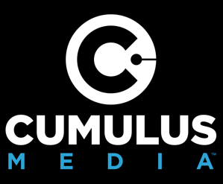
1. Add your client’s logo to the top
2. Add station logos if you are also pitching Radio and O&O Digital in your proposal.
3. Replace your name down below
DNA DIGITAL SOLUTIONS
Presented by

Slide 2
When using traditional digital marketing campaigns, 100% of the audience is anonymous.
To each targeted consumer, it will seem like you spent a million dollars on an ad campaign…
Notes:
When using traditional digital marketing campaigns, 100% of the audience is anonymous.

Slide 3
This is not your traditional digital marketing campaign. We know precisely who our audience is and, because no two people are the same, we tailor our marketing on an individual basis to those Definitive and Named Audiences.
BRITTANY
MYERS
JAMES ROBERTS
SHANELLE
ADAMS
DEFINITIVE – No anonymity, guesswork or fraud involved. We identify real people who match your ideal consumer profile, hand selected from our massive, proprietary database of both online and offline data.
NAMED – We know each person we target by name and provide their name and address at the end of the campaign.
AUDIENCES – We target those identified audiences with individualized multi-channel digital advertising based on their Digital DNA.
And we can prove it works.
Notes:
This is not your traditional digital marketing campaign…this is DNA Digital. We know precisely who our audience is and, because no two people are the same, we tailor our marketing on an individual basis specifically to those Definitive and Named Audiences. So what do we mean by that? Definitive: we’re identifying REAL people so there’s no anonymity, no guessing, and no fraud…we hand-select these real people to match your ideal consumer profile using our massive and proprietary database of both online and offline data. Named? Yes, named [CLICK], as in Brittany, James, and Shanelle - we know these people so precisely we even know their names and addresses and at the end of the campaign, I can give you that information. Once we have the perfect audience, we serve each person individualized digital advertising based on their digital DNA. AND, we can prove it works. Let’s dig in just a bit deeper…

Slide 4
The Digital DNA of a potential customer begins with their online and offline characteristics. Using our massive database of 350+ data points on nearly every adult consumer in the country, we hand select the most valuable audience for you based on verified data points.
Homeowner:
Single-family residence
Homeowner:
Single-family residence
Homeowner:
Single-family residence
Household Income:
$125,000-$150,000/yr
Household Income:
$125,000-$150,000/yr
Household Income:
$125,000-$150,000/yr
Location:
90210 zip code
Location:
90210 zip code
Location:
90210 zip code
Credit Score:
720+
Credit Score:
720+
Credit Score:
720+
BRITTANY
MYERS
JAMES ROBERTS
SHANELLE
ADAMS
Family:
Children under age 5
Mortgage Rate:
Above 3.5%
Family:
No kids
Auto Owner:
Drives a Honda with vehicle mileage 90,000+
Length at Residence: 5-7 years
Interests:
Boat Owner, Golf
Donates to Wildlife Charities
Interests:
Home Improvement, Football, Philanthropy
Education:
College Degree
Family:
No kids
Auto Owner:
Drives a 2016 Chevrolet
Political Party:
Democrat
Occupation:
Accountant
Credit Card:
Premium Bank Card
Owns E-Reader: Yes
Veteran in Household
Glasses: No
Occupation: Architect
Education:
Graduate Degree
Shopping Habits:
Wholesale Club Member
Interests:
Home Improvement, Football, Philanthropy
Occupation: Registered Nurse
Notes:
So, Digital DNA – what does that mean? It starts with a person’s online and offline characteristics. As I mentioned, we have a massive and proprietary database with over 350 data points on nearly every adult consumer in the country so we’re able to hand select the most valuable audience for you based on these verified data points – and I want to emphasize verified because we pride ourselves on the accuracy of our data. So take a look at Brittany, James, and Shanelle here. For this example, I chose four characteristics to identify my audience – they’re all homeowners with a specific household income in a specific zip code with an excellent credit score. But as you can see, if it makes sense for your campaign, we could get way more granular – in fact, I can tell you that Brittany donates to wildlife charities, and I can tell you not only that James drives a Honda but I can tell you the mileage on that Honda. And the list goes on. Is this creepy? Maybe so but what a great opportunity as a marketer to have access to this kind of targeting and efficiency.

Slide 5
We know Brittany, James, and Shanelle all meet the criteria for being your ideal customer. But because no two people are the same, they are unique in how they spend their days.
9:05 AM - Listened to Pandora on her Google Home
7:15 AM - Listened to his local morning show on his Amazon Echo
7:05 AM - Listened to a podcast on her iPhone
10:00 AM - Read homebuying tips on Realtor.com on her work computer
9:45 AM - Scrolled through his Facebook newsfeed
11:15 AM - Watched Bravo TV YouTube clips on her iPhone
BRITTANY
MYERS
JAMES ROBERTS
SHANELLE
ADAMS
12:15 PM - Streamed Mad Men on her Smart TV
11:25 AM - Viewed homes on Zillow.com on his iPad
2:35 PM - Read an article on Money.com on her work computer
6:00 PM - Visited ESPN.com on her iPad
3:05 PM – Checked his email on his work computer
6:35 PM - Streamed Great British Baking Show on her Smart TV
10:30 PM - Watched Gossip Girl YouTube clips on her Android device
9:05 PM - Searched for shoes on her laptop
11:05 PM - Streamed SNL on his Smart TV
Notes:
So we know Brittany, James, and Shanelle all meet the criteria for our target audience for this example but no two people are the same, right? We all use media differently – there are so many different devices and seemingly endless types of media to consume throughout the day. If we just look at Brittany, James, and Shanelle, you can see exactly what I mean. Brittany is listening to Pandora on her Google Home, James is listening to his local morning show [INSERT YOUR MARKET’S LOCAL MORNING SHOW IF YOU WANT] on his Amazon Echo and Shanelle is listening to a podcast on her iPhone [INSERT A LOCAL PODCAST IN HERE IF YOU WANT]. Three different people – three different places. Take it a step further, if I had to guess which of these three was visiting ESPN.com, I’d probably guess James. But I’d be wrong – Brittany is. And that’s the beauty of DNA Digital…

Slide 6
AUDIENCES: WE FOLLOW THE SPECIFIC INDIVIDUALS WITH A CUSTOMIZED CAMPAIGN ACROSS MULTIPLE CHANNELS ON THE DEVICES THEY USE
Your campaign will follow Brittany based on her unique digital DNA -- across the platforms and devices Brittany specifically uses
To each targeted consumer, it will seem like you spent a million dollars on an ad campaign… the secret is we’re just using technology to reach them more effectively.
Unlike traditional digital marketing that often selects just one place a prospect might be, our unique and advanced technology allows us to reach each targeted person across their online journey and serves them ads where we know they are.
Listened to his local morning show on his Amazon Echo
Heard your
audio ad
James will experience your brand messaging everywhere he is, as will Brittany, Shanelle, and every other unique individual we hand select, because we expertly marry his Digital DNA to your multi-channel ad campaign.
Scrolled through his Facebook newsfeed
Viewed your
social ad
JAMES ROBERTS
9876 1sT Avenue City, State
Viewed homes on Zillow.com on his iPad
Viewed your digital ad
Checked his email on his work computer
Viewed your
email
Streamed SNL on his Smart TV
Viewed your video ad
Notes:
We’re NOT guessing! We’re not simply selecting one place a prospect MIGHT be, we’re using our unique and advanced technology to serve ads to people where we KNOW they are because we’re following the actual person. So when James is listening to his local morning show [CLICK], we’re going to hit him with an audio ad. And when he’s on Facebook [CLICK], we’re going to hit him with a social ad. Same as when he’s on Zillow.com [CLICK], checking his email [CLICK] and when he’s home streaming SNL on TV, we can [CLICK] hit him with a video ad, too. So James will experience your brand messaging everywhere he is, as will Brittany, Shanelle, and every other unique individual we hand select because we’re connecting their Digital DNA with the multi-channel ad campaign we create.

Slide 7
AND WE CAN PROVE IT WORKS!
Because we know the name of everyone who saw your DNA Digital campaign, we can prove ROI in an unprecedented way – you can match those names to your new leads and customers.
BRITTANY
MYERS
JAMES ROBERTS
SHANELLE
ADAMS
To each targeted consumer, it will seem like you spent a million dollars on an ad campaign…
Notes:
And, we can prove it works! Because we know Brittany, James, and Shanelle by name, you can take the list of everyone we reached and match those names to your new leads and customers offering the ability to prove ROI in an unprecedented way. So we’ve gone ahead and selected an audience we think best matches your ideal prospect.

Slide 8
SPEC COUNT

Slide 9
We identified the most relevant target audience for you.
A best practice is to always include a spec count to illustrate how it works. Personalize this page to reflect what you heard from the advertiser during the CNA (and/or from your own research), as well as the targeting criteria you incorporated when pulling a count with your preferred C-Suite partner.
You want to reach...
High-value homeowners within your business areas that have strong credit and are likely either already in the market to refinance their homes or can be convinced to do so with powerful offers/reminders.
Memphis, Nashville & Jackson DMAs
Homeowners
HHI of $100k+
Home Value of $400k+
"Good" or "Excellent" Credit (670+)
Mortgage Interest Rate of 3.25%+
There are 38,409 people total that match your ideal customer profile. We can reach them!
Notes:
In total, we found XXXX people who matched all of your key targeting parameters.
So, this is our campaign audience -- an important first step to establish. That’s because when we develop a campaign plan, that plan will be designed exactly around hitting each one of these people a specific number of times per month, across several digital channels and platforms, to build highly-focused resonance and frequency toward driving some sort of action throughout the campaign period. It’s measured and appropriate ad coverage for your customized audience - no ridiculous spends or guesses on budgets.
By the way, this specificity in defining the audience is a key differentiator with our DNA Digital campaigns. No one else can forecast the exact audience who’ll see your ad campaign -- let alone offer to identify them. And, speaking of which, the number of people you see here is how many identities we will give you post-campaign so that you can truly have transparency on the audience that you've reached.

Slide 10
DIGITAL EXPERT ADDITIONS
Notes:
The following slides can be used by any rep who feels comfortable going a little further into the details of the program and/or feels comfortable pitching the particular platforms. Otherwise, these can be used by a DSM.

Slide 11
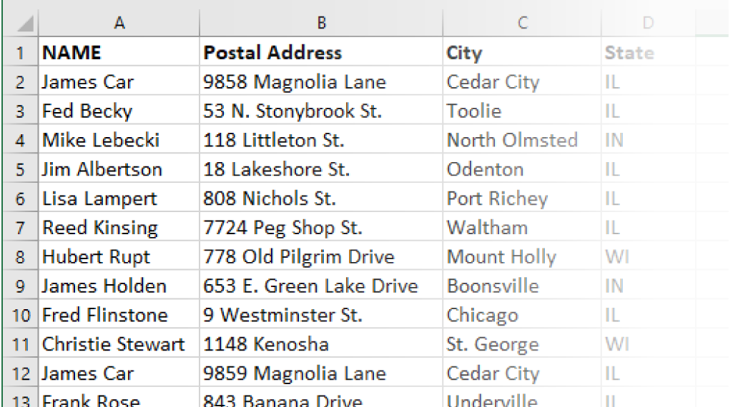
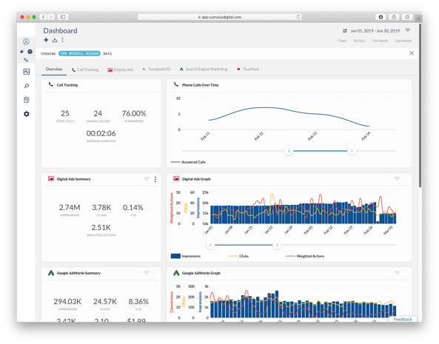
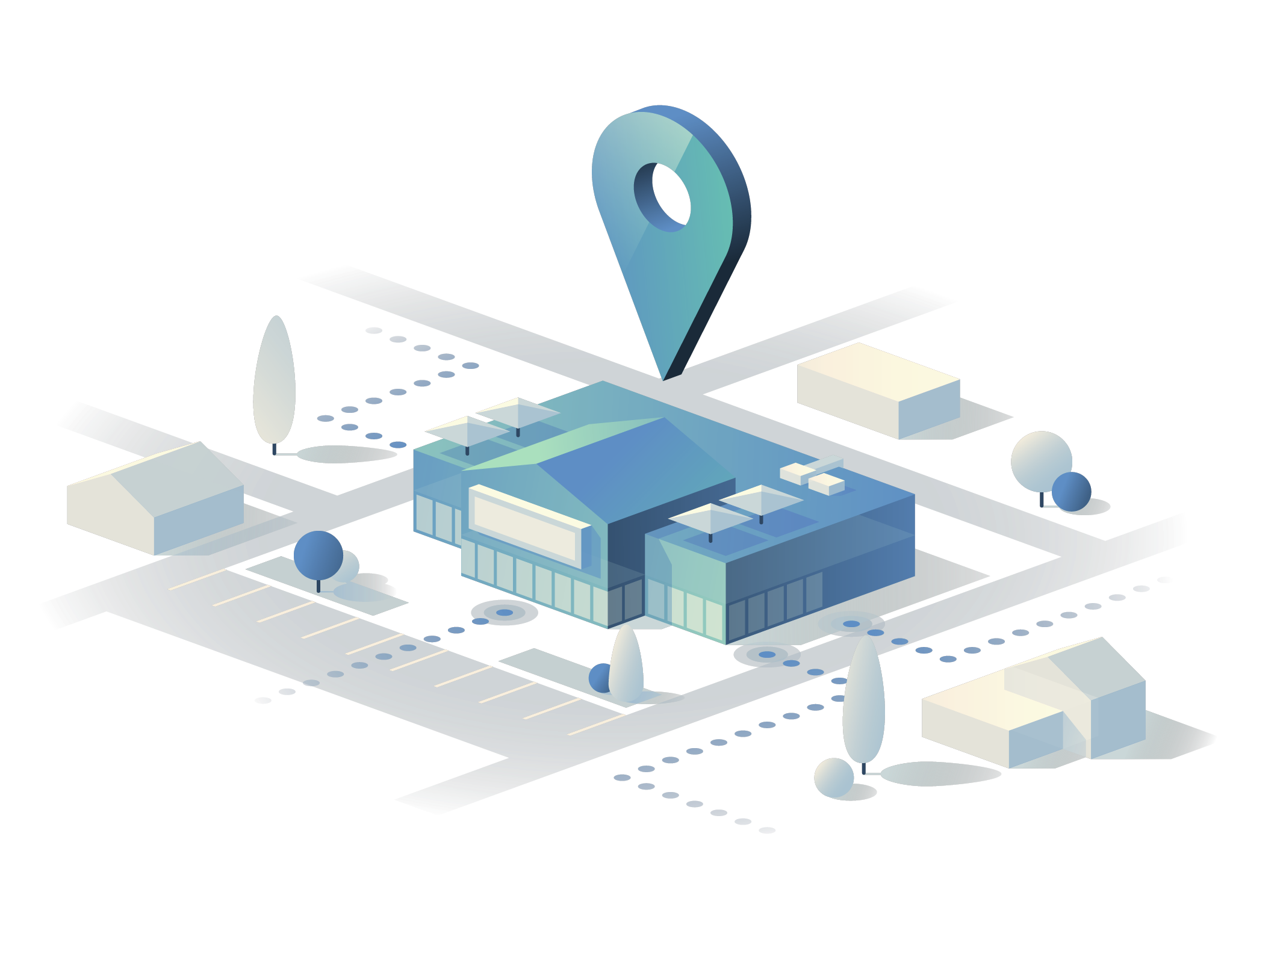
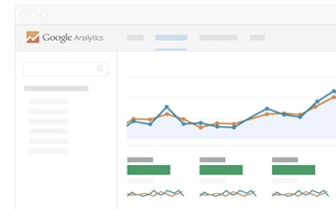
By tracking engagement online and in-store, we can further optimize your campaign to ensure that our ad-exposed audience and your marketing dollars are truly generating measurable results.
Tip: Remind them that they’ll get a full identity export of everyone we targeted with the DNA portion of our campaign. This is our unique selling proposition! It’s very valuable in illustrating our targeting, transparency, and matchback attribution.
Full Customer Matchback
via audience identity export
Performance Dashboard
track delivery and engagement
Conversion Measurement
via tracking pixel and analytics
In-Store Visitor Attribution
foot traffic measurement
Notes:
The best part of DNA Digital is the attribution. Because we knew the identity of everyone we targeted before we served a single impression of your campaign, it allows us to do something that’s quite unique to us – we’re going to provide a full export of our targeted audience that you can keep.
Why do we do this? Well, first off – we set out with a very specific mission: to solve the issue of fraud and waste in the digital arena. This kind of transparency allows us to prove that we’re accomplishing this. In fact, you could go down the list and ask each person if they saw your email or your banner ad, and they should say “yes” because that was the only time that we fired those impressions – when it was in front of them. But, beyond that, use this list to match back to your inbound leads and sales as proof of these people making that conversion leap. Those matches are a true measurement of ROI!
Obviously, we’ll also do all of the traditional digital tracking that you’d expect with a campaign like this in our performance dashboard – but, beyond the clicks, impressions, and engagements, we’ll also utilize a “tracking pixel” to follow the user journey once they visit your site – and, more importantly, it’ll allow us to match different devices to the same person (which Google Analytics would otherwise see as two different people) which will help us adjust the campaign delivery based on their conversion actions.
We can also measure in-store foot traffic from our audience too. Put simply, we want to see (in every capacity that we’re able) when someone who was exposed to our campaign then subsequently stepped foot inside of your store location.
Are all of these attribution methods perfect? Absolutely not. But happily, we’ve got more technology and visibility than ever before, and these methods can help us tell the success story and define true wins from our DNA Digital audience (above and beyond the general lift in phone calls, leads, and sales that we expect you to see during/after your campaign).

Slide 12
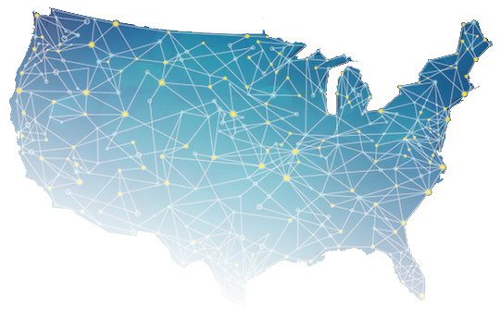
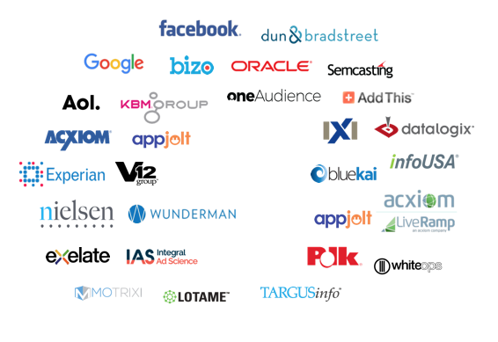
We've built a massive database of REAL people
utilizing a wealth of data to reach the right audiences consistently
AUDIENCE SCALE
DATA PRECISION
ONE OF THE WORLD’S LARGEST MEDIA COMPANIES
ONE OF THE LARGEST NETWORKS OF DATA PARTNERS
WITH OVER 400 STATIONS ACROSS NEARLY 100 MARKETS
WITH A REAL-TIME DATA FIREHOSE FROM OVER 35 PROVIDERS
+
WE IDENTIFY OVER
80%
OF THE POPULATION AND THEIR DEVICES
WE COLLECT UP TO
350
TOTAL DATA POINTS
ONLINE & OFFLINE

Slide 13
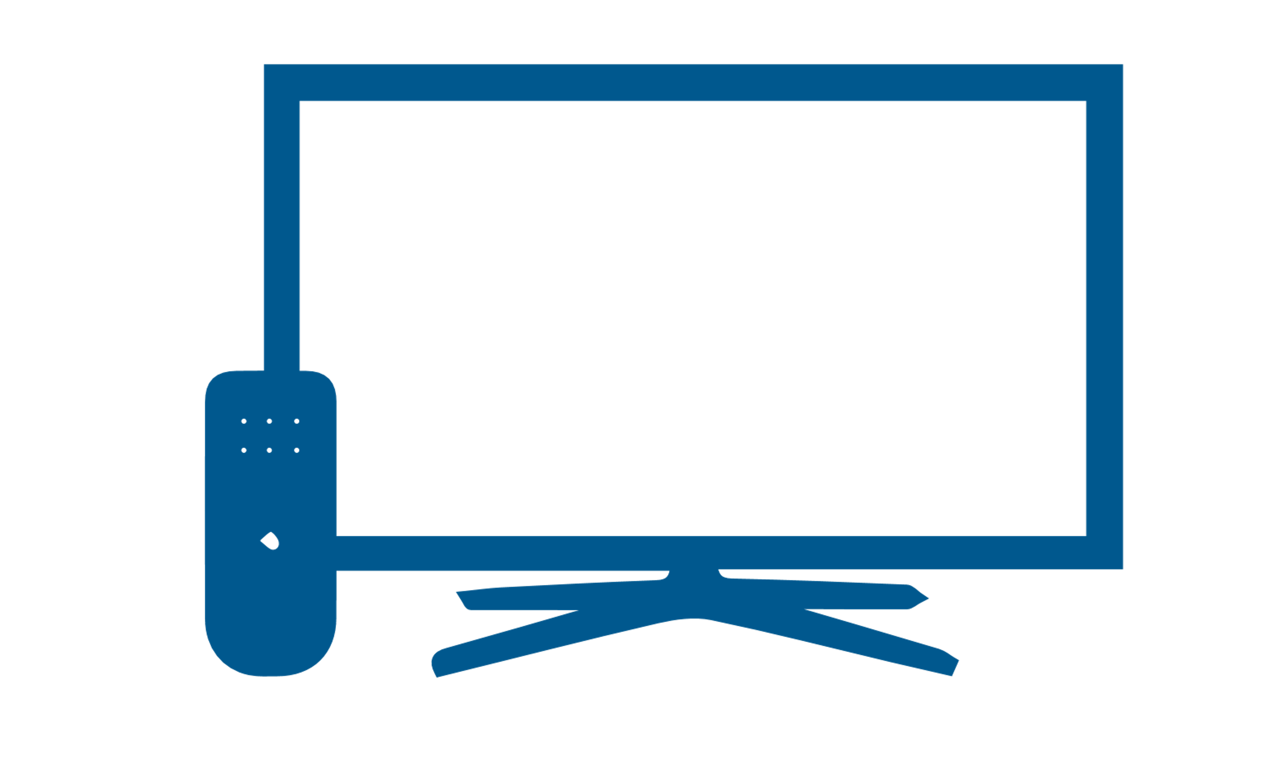
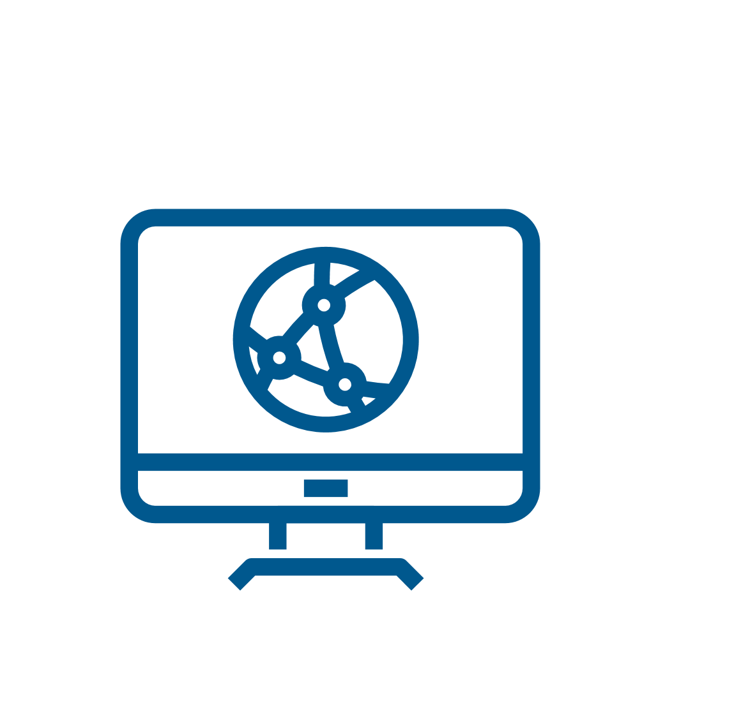
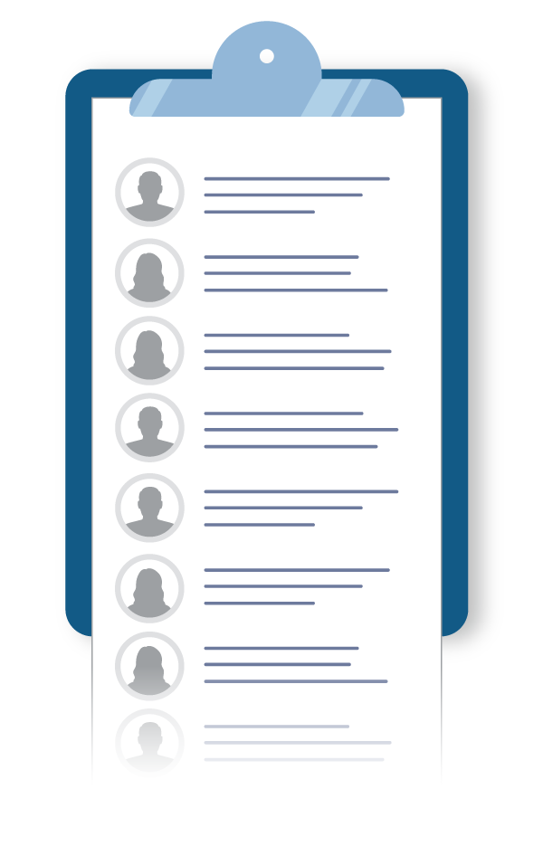
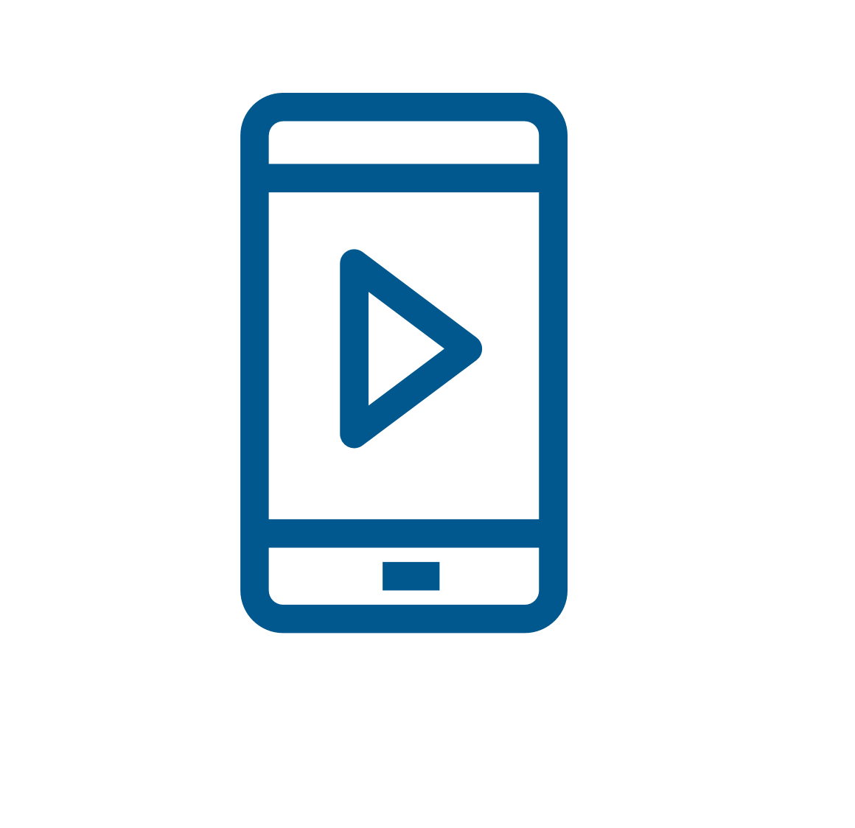
Build multi-channel ad coverage
We follow each targeted consumer across several channels, platforms, and devices to immerse them with resonance, frequency, and repeated engagement
Now we'll choose which tactics and how frequently we'll use them to target our fully identified DNA Digital audience to get the maximum impact.
To each targeted consumer, it will seem like you spent a million dollars on your ad campaign… the secret is that we’re just using our technology to reach them far more effectively.

Slide 14
OUR RECOMMENDATION
This page includes every option available in DNA Digital. Customize this page based on your recommendation(s) for your client.
CLIENT LOGO HERE
EMAIL DEPLOYMENTS XX,XXX total monthly impressions
Long-form email messages sent to the inboxes of your targeted individuals for one-to-one marketing.
Xx
PER PERSON PER MONTH
DISPLAY BANNERS XX,XXX total monthly impressions
Desktop & mobile ads that follow your audience across all the websites and apps that they’re visiting.
Xx
PER PERSON PER MONTH
NATIVE PLACEMENTS XX,XXX total monthly impressions
Organically-placed contextual ads that appear to be part of that website content that's being viewed.
Xx
PER PERSON PER MONTH
SOCIAL PLACEMENTS XX,XXX total monthly impressions
Highly-impactful social ad placements that appear in-feed for people matching our targeting criteria.
Xx
PER PERSON PER MONTH
STREAMING AUDIO ADS XX,XXX total monthly impressions
Targeted commercials that play within streaming audio content (music, news, sports, or podcasts).
Xx
PER PERSON PER MONTH
VIDEO PRE-ROLL ADS XX,XXX total monthly impressions
Highly-impactful video ads that appear before high-quality content playing on websites or mobile apps.
Xx
PER PERSON PER MONTH
CONNECTED TV / OTT XX,XXX total monthly impressions
Non-skippable video commercials that play within streaming video content (Smart TVs and other devices).
Xx
PER PERSON PER MONTH
$X Per Month
X-Month Investment: $X Total
X-Month Reach: X+ Impressions
X pre-identified individuals will be followed by roughly X monthly ad impressions for an average cost of only X¢ per person per month.
________________________________________________________________ ____________________
Client Signature Date Signed
Notes:
Now let’s look at how a plan comes together for your audience...

