Slide 1



Holiday Packages

Slide 2









Find Your Ideal Holiday Shoppers
Our digital marketing strategy gives you the ability to pinpoint holiday shoppers who are searching for your products
People
Connect with shoppers who are currently looking for the products you sell
Reach
Deliver compelling ads to your target audience across all of their devices at a high frequency the way they want to be reached
Results
Know you’re making the most out of every ad dollar spent with our clear measurement solutions

Slide 3







Three Easy Steps to Finding Your
Next Holiday Shopper
1. Identify REAL People
We have a first-party consumer database with over 250 million people in it. Every person has opted-in and given us permission to track their interests and serve them relevant ads.
We have a detailed profile of every person we’ll reach during your campaign which allows us to know exactly who they are, what they’re searching for, how they prefer to receive advertisements, and then track whether or not they convert by visiting your retail location, visiting your website, or buying your product.
Sam Cohen
07452
Female
22yrs
Within the past 30 days Sam has:
Used her Amazon & Zappos apps
Visited three websites similar to yours
Used Google to search for a product you sell
Researched the best place to buy a product you sell
Compared pricing online for a product you sell

Slide 4
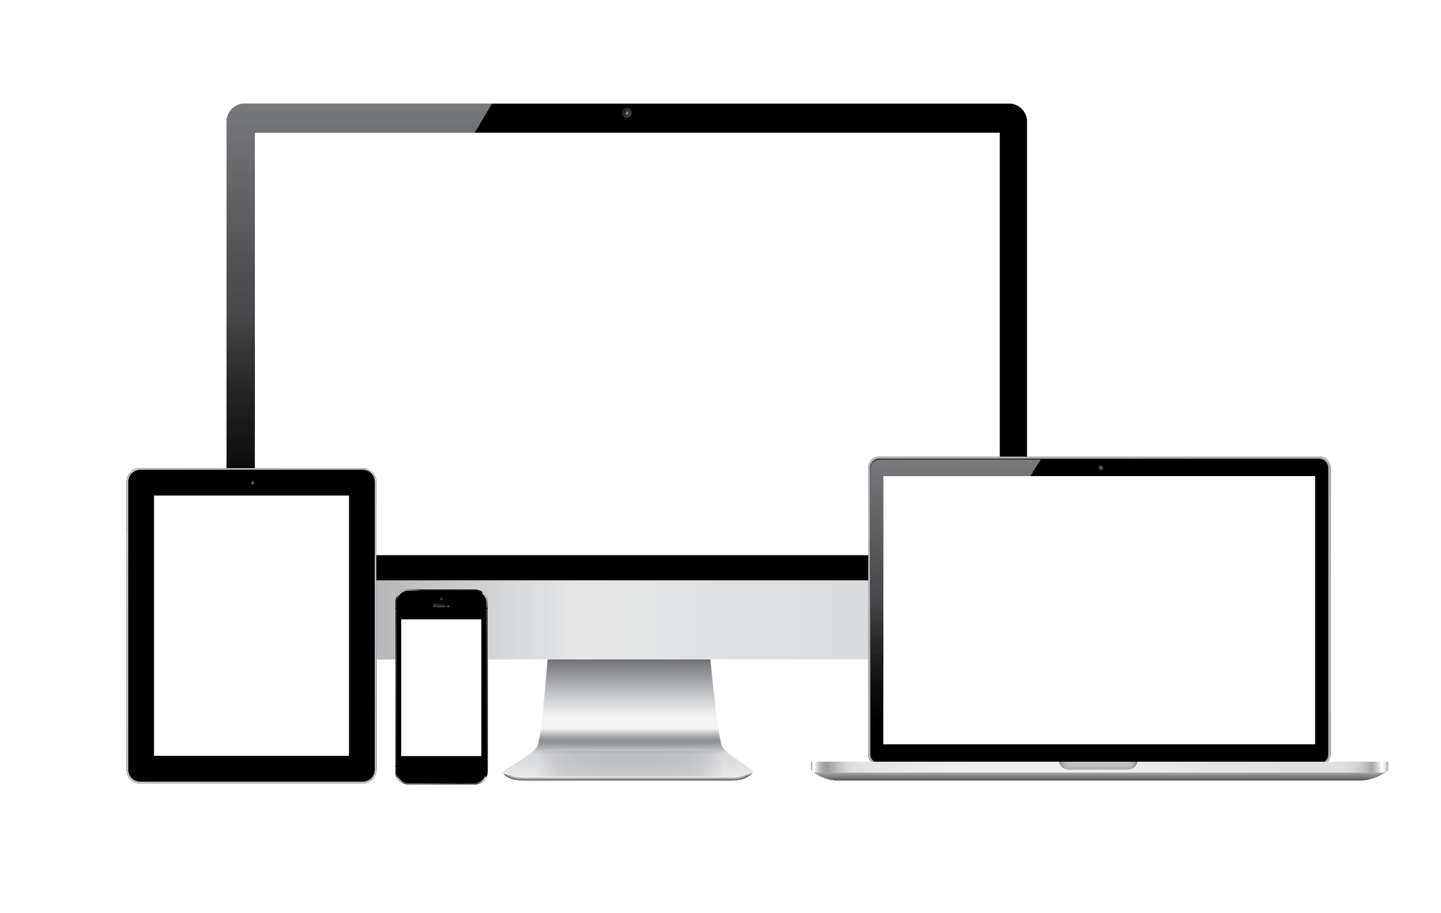
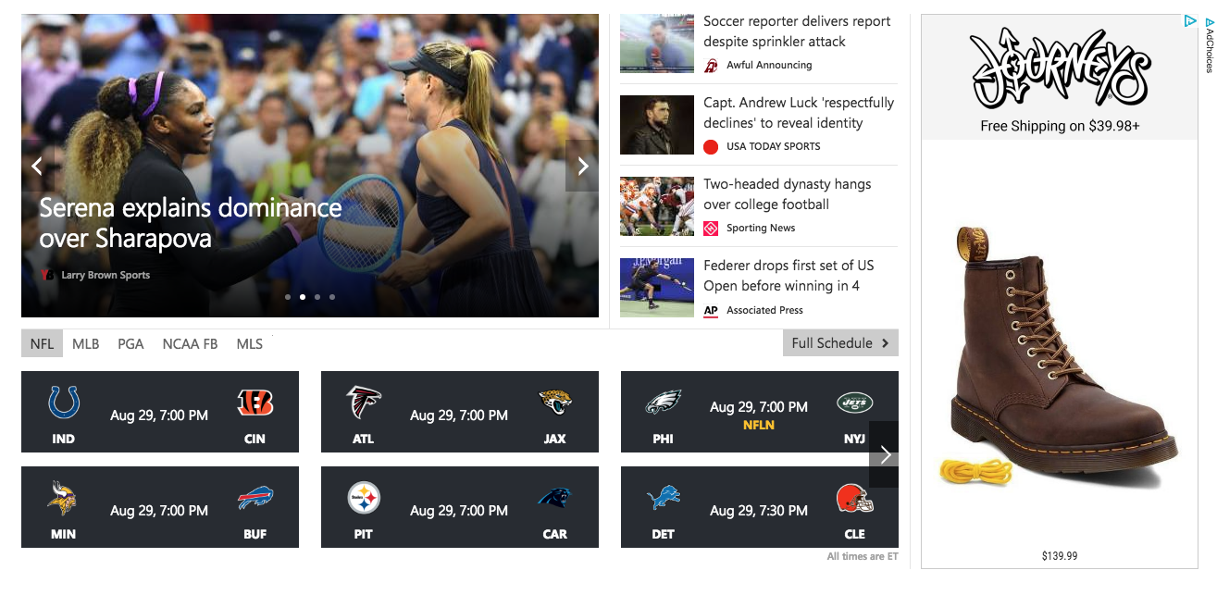
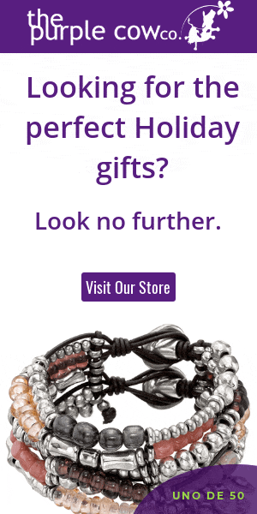


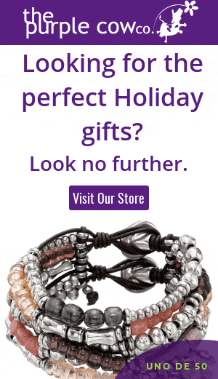
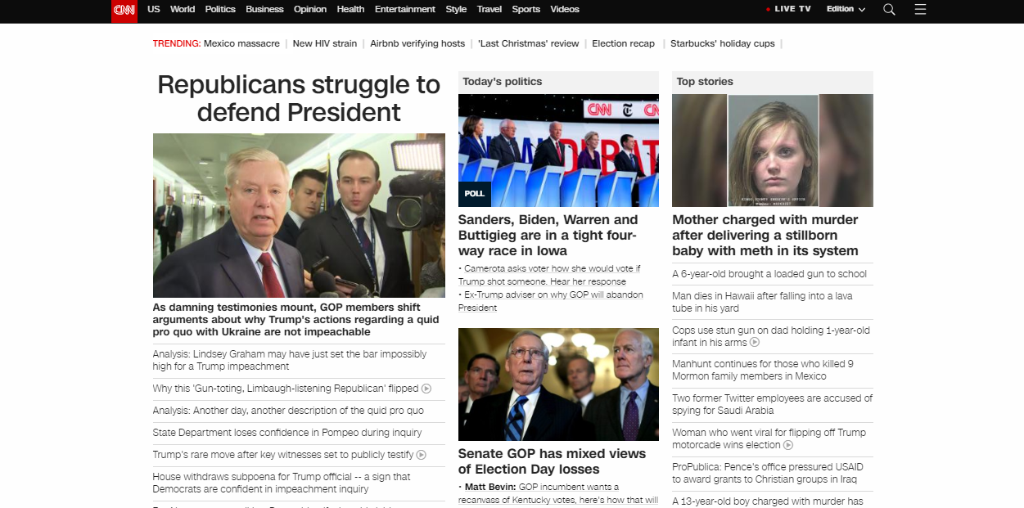
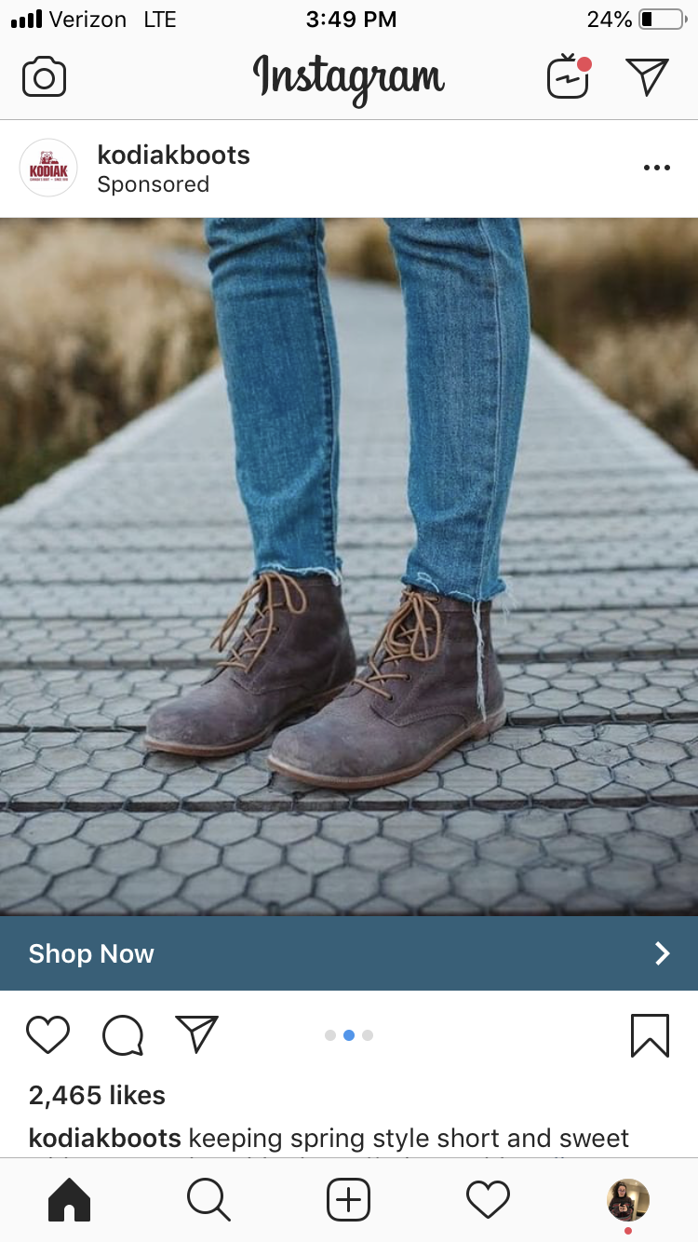
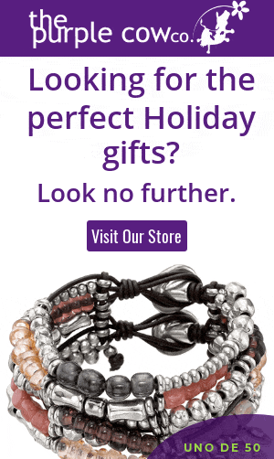

Three Easy Steps to Finding Your
Next Holiday Shopper
2. Connect with your message
Once we identify the specific people we want to reach, we’ll serve each person an Email, a follow up Email a week later, and a high frequency of banner ads on desktop sites, mobile sites and apps, social media, and native channels.

Slide 5


Three Easy Steps to Finding Your
Next Holiday Shopper
3. Prove results!
At the end of your campaign we’ll be able to show you very clearly the following metrics:
# of Impressions
# of Clicks
Top performing ad channels
Names & Postal addresses of each person who opened and/or clicked a link inside the Email or Remail
Names & Postal addresses of each person who was served an ad
# of People who visit your website and/or make a purchase from your website
Matchback analysis to show how many of your customers were influenced by our campaign

Slide 6
Holiday Packages
FEATURES & BENEFITS:
We’ll target at least 15,000 relevant people per campaign (our experience proves that larger audiences lead to better performance)
We define “relevant people” as someone who has taken multiple actions within the past 30 days (targeting a 30-day window allows us to keep our ads in front of relevant eyeballs longer, leading to a more powerful ad strategy)
We’ll use Email, Remail, Desktop, Mobile, Social, and Native channels (we’ll send our Remail to everyone in the entire audience whether they opened it or not. Email is an extremely effective way to communicate all the products you offer, services, customer testimonials, time sensitive promotions, and more so we want to hit everyone in the audience with the Remail, ESPECIALLY if they didn’t get the chance to open the first email)

Slide 7
Holiday Packages
FEATURES & BENEFITS:
We’ll focus on serving a high ad frequency to the entire audience group, serving ads on the channels mentioned above whenever possible (We want to hit these people every day on as many sites, channels, and devices as possible to get the best results)
We’ll provide a list of the Openers and Clickers of the Emails and Remails we deploy (list will include first name, last name, and postal address of where they reside)
We recommend all campaigns be 30+ days in length (it’s important to stay top of mind for at least 4 weeks in order to increase the chances that our audience will engage with our ads and convert)

Slide 8
Holiday Packages
Make sure you are always starting with a summary of your radio plan. Add the digital proposal to the campaign.
Remember, all digital packages are foundational. Consult with your Bridge Account Manager to tweak the packages to better suit your market or a specific client.
Add an outline for the radio that is incorporated in this campaign.
15,000 Audience Package
Includes:
Email to 15,000 people
65,000 impressions split between desktop, mobile & social
Ad Frequency: 5 per person
All creative & coding services
Pixel tracking (optional)
Matchback report and analysis
Total: [RADIO $] + $1,600

Slide 9
Holiday Packages
Make sure you are always starting with a summary of your radio plan. Add the digital proposal to the campaign.
Remember, all digital packages are foundational. Consult with your Bridge Account Manager to tweak the packages to better suit your market or a specific client.
Add an outline for the radio that is incorporated in this campaign.
15,000 Audience Package
Includes:
Email to 15,000 people
Remail to 15,000 people 1 week later
85,000 impressions split between desktop, mobile & social
Ad Frequency: 8 per person
All creative & coding services
Pixel tracking (optional)
Matchback report and analysis
Response data file (names & postal addresses of email openers & clickers)
Total: [RADIO $] + $2,300

Slide 10
Holiday Packages
Make sure you are always starting with a summary of your radio plan. Add the digital proposal to the campaign.
Remember, all digital packages are foundational. Consult with your Bridge Account Manager to tweak the packages to better suit your market or a specific client.
Add an outline for the radio that is incorporated in this campaign.
30,000 Audience Package
Includes:
Email to 30,000 people
Remail to 30,000 people 1 week later
150,000 impressions split between desktop, mobile & social
Ad Frequency: 7 per person
All creative & coding services
Pixel tracking (optional)
Matchback report and analysis
Response data file (names & postal addresses of email openers & clickers)
Total: [RADIO $] + $3,000

Slide 11
Holiday Packages
Make sure you are always starting with a summary of your radio plan. Add the digital proposal to the campaign.
Remember, all digital packages are foundational. Consult with your Bridge Account Manager to tweak the packages to better suit your market or a specific client.
Add an outline for the radio that is incorporated in this campaign.
50,000 Audience Package
Includes:
Email to 50,000 people
Remail to 50,000 people 1 week later
235,000 impressions split between desktop, mobile & social
Ad Frequency: 7 per person
All creative & coding services
Pixel tracking (optional)
Matchback report and analysis
Response data file (names & postal addresses of email openers & clickers)
Total: [RADIO $] + $4,000

Slide 12
Holiday Packages
Make sure you are always starting with a summary of your radio plan. Add the digital proposal to the campaign.
Remember, all digital packages are foundational. Consult with your Bridge Account Manager to tweak the packages to better suit your market or a specific client.
Add an outline for the radio that is incorporated in this campaign.
75,000 Audience Package
Includes:
Email to 75,000 people
Remail to 75,000 people 1 week later
365,000 impressions split between desktop, mobile & social
Ad Frequency: 7 per person
All creative & coding services
Pixel tracking (optional)
Matchback report and analysis
Response data file (names & postal addresses of email openers & clickers)
Total: [RADIO $] + $5,800

Slide 13
Holiday Packages
Make sure you are always starting with a summary of your radio plan. Add the digital proposal to the campaign.
Remember, all digital packages are foundational. Consult with your Bridge Account Manager to tweak the packages to better suit your market or a specific client.
Add an outline for the radio that is incorporated in this campaign.
100,000 Audience Package
Includes:
Email to 100,000 people
Remail to 100,000 people 1 week later
465,000 impressions split between desktop, mobile & social
Ad Frequency: 7 per person
All creative & coding services
Pixel tracking (optional)
Matchback report and analysis
Response data file (names & postal addresses of email openers & clickers)
Total: [RADIO $] + $7,300

Slide 14

THANK YOU!

