Slide 1
Driving Election Results
STATION LOGO
HERE

Slide 2
Your Objectives
Insert objectives gathered during the CNA. Examples of objectives include:
INFLUENCE: Get my base to cast their vote
AWARENESS: Reach [political party] voters and stand out from the crowd by differentiating yourself
PERSUADE: To win over the undecided voters
Show that you heard them and plan to share solutions that solve their challenges!

Slide 3
Listeners Don’t Vote For
Politicians They Don’t Know
BE KNOWN: Create name awareness with our massive reach
BE REMEMBERED: Connect your name to your point of view and important issues
BE ELECTED: Motivate and activate voters to go to the poll to vote for you

Slide 4
Eight Characteristics of the
Best-Performing Local Advertising
Outdoor
Broadcast TV
Cable TV
Newspaper
Direct Mail
Digital
Radio
1.
2.
3.
4.
5.
6.
7.
8.
Reach Your Potential Customers
Only RADIO meets all the requirements for delivering the BEST results for local advertisers
Influence Close to Point of Purchase
Provide Local Consumer Interactions
Create Emotional Connections
Build Trust & Credibility
Provide Un-skippable Engagement
Be Cost Effective
Deliver Affordable Ads Quickly

Slide 5
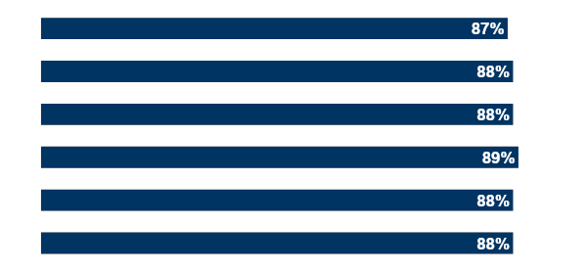
Radio delivers massive reach across all political party segments
% of Nielsen voter rating segments reached by radio
No party
Independent
Independent, but feels closer to Democrat
Independent, but feels closer to Republican
Democrat
Republican
How to read: Radio reaches 88% of people who affiliate with the Republican party.
Source: Scarborough USA+ 2018 Release 2 Total (Jul 2017 - Nov 2018).

Slide 6
Advertising on Multiple Platforms Increases Impact
Incremental Impact by Adding Platforms
+ 35%
+ 31%
+ 23%
+ 19%
71% of campaigns are on more than 1 Platform
1 Platform
2 Platforms
3 Platforms
4 Platforms
5 Platforms
Source: Analytic Partners, 2016; Analysis based on over 3,200 ad campaigns from 2010-2015; platforms include TV, Print, Radio, Display, Paid Search, Online Video, PR, OOH and Cinema. % of 3,200 advertising campaigns on up to 5 platforms.

Slide 7
BELOW IS ONLY AN EXAMPLE: ALWAYS CUSTOMIZE THE IDEAL VOTER PROFILE BASED ON WHAT YOU LEARNED IN YOUR CNA TO CREATE A MOCK PROFILE FOR JANE SMITH
We Can Target Your Ideal Voters
We know everything about your ideal voters – even their names!
We have access to 350 data points on 80% of the population.
Your ideal prospect
Proprietary voter profiles
found in our massive database
Identified by name
IDEAL VOTER PROFILE:
Female, age 25-45 years old
Registered Democrat or likely to vote against registered party
Lives within the State, County, or City
Household income $60K+
Donated in a previous election season
Recently searched for “best democratic election candidates”
Has children
Social Influential Score
+
Donation/Contribution
+
Economics & Social Issues Score
+
Veteran in the Household
+
Jane Smith
Female, Age 32
Democrat
435 Main Street
Income $63K
Went to college
Has a child in Catholic school and a veteran spouse
Previously attended political rallies
Constitutional Liberty Score
+
Home Patriot Score (National Security & War on Terror)
+
Border Security Security/Immigration Score
+
Ethic Code/Group/Languages

Slide 8
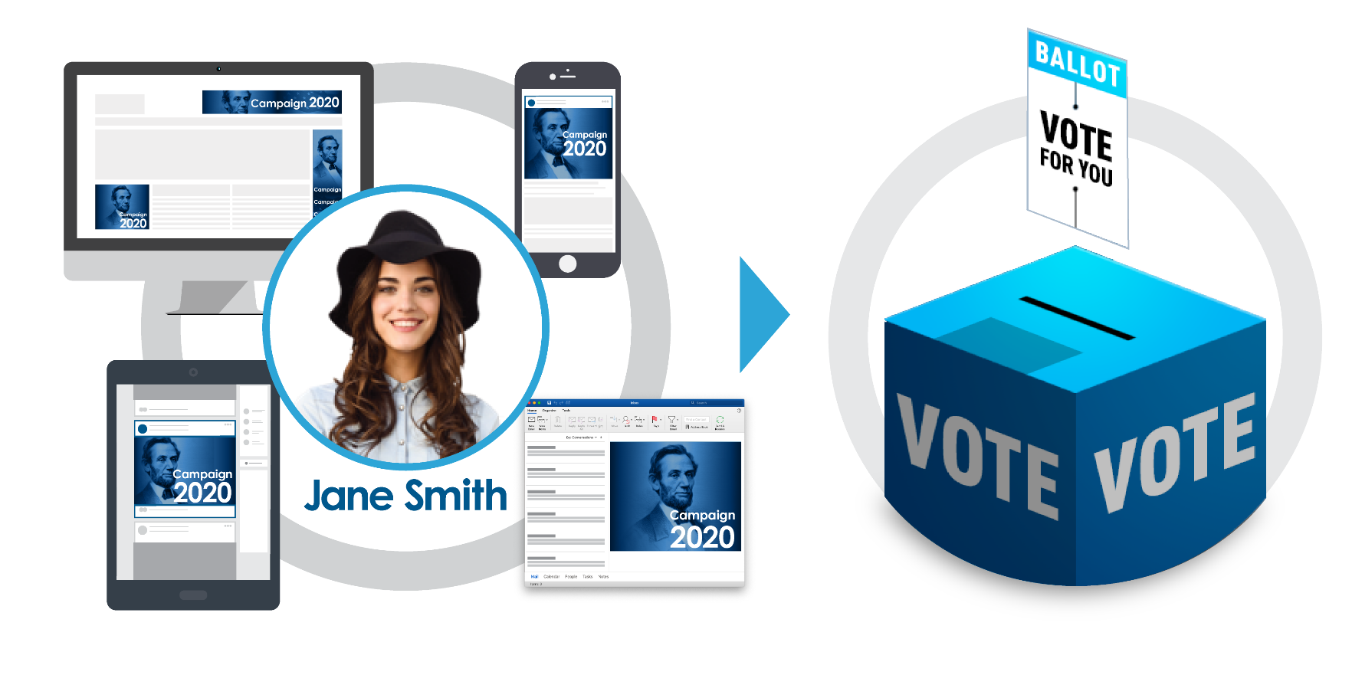
Communicate and Connect with Voters
via High Frequency Media
We customize your campaign to reach your potential voters everywhere they go online!
We will only serve ads to the devices that the voter most frequently uses.
Available Tools: Crossed-Device Display, Pre-Roll Video, Contextual Native, ConnectedTV, and Responsive Email

Slide 9
Response Data Report
The Response Data Report will show you exactly who engaged with your E-Mail. You’ll see who opened it, and who clicked your email links to visit your website and learn more. This helps your sales team identify the local consumers who are HOTTEST to vote

Slide 10
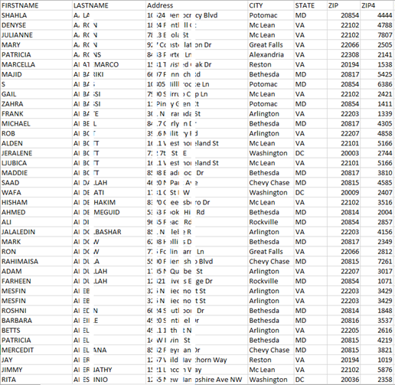
Postal Data Report
The Match-Back Report will show you the First & Last names, and Street Addresses of each person who receives your ad.
(i.e. if we identify 63,274 people who fit your target audience description, and we send each of those people your email & multi-channel ads, we’ll send you an excel file with the names & addresses of those 63,274 people)
This allows you to compare this list to the people who convert (make a donation, fill out a form, sign up for your mailing list, etc.) so we can prove the ROI of your campaign.

Slide 11
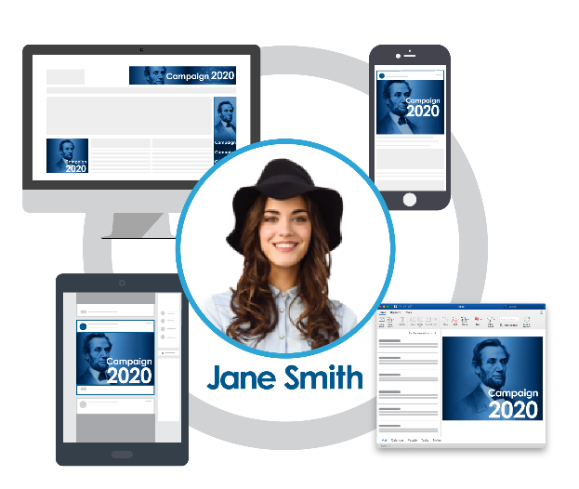
Be Known. Be Remembered. Be Elected.
Radio Delivers All 8 Common
Characteristics That Drive Best Results
Digital Solutions Hyper-Target Voters You Want
Reach Your Potential Customers
Influence Close to Point of Purchase
Provide Local Consumer Interactions
Create Emotional Connections
Build Trust & Credibility
Provide Un-Skippable Engagement
Be Cost Effective
Deliver Affordable Ads Quickly
Multiple Media Platforms Perform Best
We Are Your One Stop Solution To Be Elected
+ 31%
+ 35%
+ 23%
+ 19%
1
2
3
4
5
Source: Radio: Nielsen 2014-2016 ROI studies; Direct Mail: Data & Marketing Association, 2015 (via marketingcharts.com); TV/Print/Outdoor/Digital: BrandScience, “Out Of Home Advertising Today”, OAAA, 2016 Source: Analytic Partners, 2016; Analysis based on over 3,200 ad campaigns from 2010-2015; platforms include TV, Print, Radio, Display, Paid Search, Online Video, PR, OOH and Cinema. % of 3,200 advertising campaigns on up to 5 platforms.

Slide 12
Let’s Get Elected
INSERT YOUR COORDINATED RADIO AND DIGITAL CAMPAIGN THAT SOLVES THE CAMPAIGN’S OBJECTIVE(S) YOU LAID OUT IN THE BEGINNING
REMEMBER TO TIE YOUR CAMPAIGN ELEMENTS DIRECTLY BACK TO THEIR SPECIFIC CAMPAIGN GOALS
IMPORTANT: FOR POLITICAL ADVERTISING ONLY, YOU MUST SHOW TWO PRICES: ONE FOR RADIO AND ONE FOR DIGITAL
THE FOLLOWING SLIDES ARE SAMPLE PACKAGES FOR DIFFERENT PRICE RANGES. THESE ARE ALL CUSTOMIZABLE. PLEASE CHECK WITH VENDOR FOR MOST APPROPRIATE PRICING FOR YOUR CLIENT.

Slide 13
SELECT ONE PACKAGE ONLY TO SHARE WITH A CLIENT.
PLEASE CHECK WITH VENDOR FOR MOST APPROPRIATE PRICING FOR YOUR CLIENT.
Let’s Get Elected
 | Package
Leads from Cumulus Database Emails & Addresses of People Who Are Persuadable Voters | Up to 40,000 Persuadable Voters
Delivery of Emails and Remail Targeting Voters | Up to 40,000 per deployment
Postal Data File | ✓
Response Data File | ✓
Creative and Coding | ✓
C-Auto Package Totals | $1,500
Client Signature: _____________________________ Print: __________________________ Date: __________

Slide 14
SELECT ONE PACKAGE ONLY TO SHARE WITH A CLIENT.
PLEASE CHECK WITH VENDOR FOR MOST APPROPRIATE PRICING FOR YOUR CLIENT.
Let’s Get Elected
 | Package
Leads from Cumulus Database Emails & Addresses of People Who Are Persuadable Voters | Up to 40,000 Persuadable Voters
Delivery of Emails, Remail, Display and Mobile Display Targeting Voters | 210,000 Impressions
Postal Data File | ✓
Cross Device Pixel Tracking | ✓
Response Data File | ✓
Creative and Coding | ✓
C-Auto Package Totals | $3,000
Client Signature: _____________________________ Print: __________________________ Date: __________

Slide 15
SELECT ONE PACKAGE ONLY TO SHARE WITH A CLIENT.
PLEASE CHECK WITH VENDOR FOR MOST APPROPRIATE PRICING FOR YOUR CLIENT.
Let’s Get Elected
 | Package
Leads from Cumulus Database Emails & Addresses of People Who Are Persuadable Voters | Up to 50,000 Persuadable Voters
Delivery of Emails, Remail, Display, Mobile Display, and OTT Targeting Voters | 300,000 Impressions
Postal Data File | ✓
Cross Device Pixel Tracking | ✓
Response Data File | ✓
Creative and Coding | ✓
C-Auto Package Totals | $5,000
Client Signature: _____________________________ Print: __________________________ Date: __________

Slide 16
SELECT ONE PACKAGE ONLY TO SHARE WITH A CLIENT.
PLEASE CHECK WITH VENDOR FOR MOST APPROPRIATE PRICING FOR YOUR CLIENT.
Let’s Get Elected
 | Package
Leads from Cumulus Database Emails & Addresses of People Who Are Persuadable Voters | Up to 75,000 Persuadable Voters
Delivery of Emails, Remail, Display, Mobile Display, and OTT Targeting Voters | 650,000 Impressions
Postal Data File | ✓
Cross Device Pixel Tracking | ✓
Response Data File | ✓
Creative and Coding | ✓
C-Auto Package Totals | $10,000
Client Signature: _____________________________ Print: __________________________ Date: __________

Slide 17
Appendix

Slide 18
Targeted Emails
There are several benefits of kicking off a campaign with an Email:
Over 90% of consumers check their email at least once a day which means it’ll be seen quickly by relevant people
Consumers make the choice to check their email. By putting the consumer in control of opening the email and viewing our ad, their receptivity is up and they’ll be much more likely to pay attention, retain the information, and engage
As an advertiser, you’ll have far more space to communicate a lot of great information to your target audience that you wouldn’t normally have with smaller digital banner ads that don’t give you enough room to be compelling and engaging
The initial email is the part of the digital media strategy that will capture the consumers’ attention in a non-invasive way

Slide 19
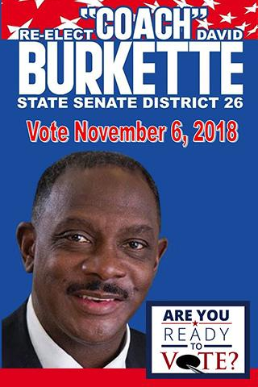
Desktop & Mobile:
Banner Ads
Successful advertising is all about hitting the same relevant people over and over again at a high ad frequency. To accomplish this, we will serve desktop & mobile banner ads to the same targeted group of people who received your Email. These ads will be served at a high frequency across all devices the consumers own and on the sites or apps they use most often.
While the Email captures their attention, it’s these banner ads that keep the campaign top of mind and usually lead to the conversions.

Slide 20
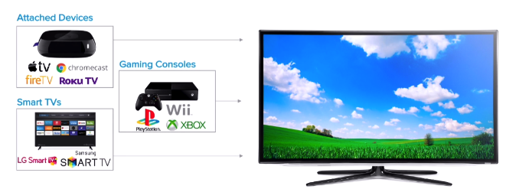
Local Video:
Over the Top Devices
OTT Content (Over-The-Top Advertising) refers to video content delivered to a consumer via OTT devices that are connected to the internet, a method that bypasses traditional cable or satellite set-top-boxes.
We have grouped OTT devices into the following two categories:
CTV [Connected TV] Devices refer to the method by which OTT Content is consumed on a TV screen when it’s connected to the internet (i.e. Samsung Smart TV) OR a device that streams media from the internet to your TV. (i.e. Roku, Google Chromecast)
Other devices refer to the method by which OTT Content is consumed on a mobile, desktop, or tablet device.

Slide 21
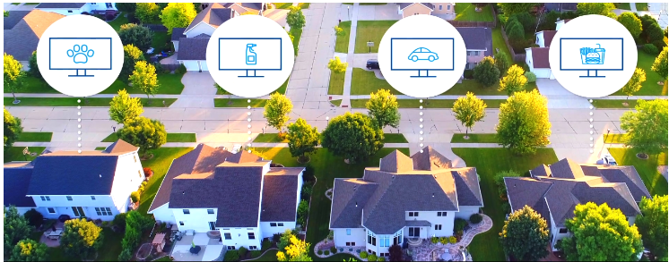
Local Video:
Over the Top Devices
HIGH
VISIBILITY
BOOSTED BRAND AWARENESS
INCREASED CONVERSION RATES
PRECISE AUDIENCE TARGETING
Achieves high viewability & a 90%+ completion rate on premium display & mobile inventory
Guaranteed brand exposure since ads are not skippable & must play in their entirety.
OTT media ads can be clickable to provide deeper insights and reporting.
Ads can be more targeted to the viewer’s personal interests.

Slide 22
THANK YOU!

