Slide 1
Connect with People

Slide 2
We solve one of marketing’s most daunting challenges: finding your next customer.
Our unique data connects you to REAL people wherever they are and with complete transparency, from first touch to attribution
We connect you to real people across every media channel and device.
Because we're connecting you with actual individuals, we can accurately measure how well your campaign performs.
is your ideal partner
‹#›
‹#›

Slide 3
DATA QUALITY YOU CAN TRUST
Our Difference
Unparalleled Data Coverage - our database reaches all marketable adults in the United States. Our data is embedded in the entire digital advertising economy. We are the white label source for almost all of the major data players in the marketplace. Permission, Transparency and Trust - our PII data is 100% secure, permissioned-based and opt-in and we have complete ownership of our data Accurate, Timely & Complete Audience Data - we connect the email addresses of real people to a wealth of permission-based signals that help us better understand their behaviors, interests, consumption patterns, and more Customer Success - we are your trusted real people-based marketing partner with expertise in account management, data science and multichannel media strategy and will provide full service end-to-end campaign support
We already know your next customer
‹#›

Slide 4
Benefits of Partnering with
Ethically-Sourced, High Quality Data Our data is 100% permission-based, opt-in and CCPA, GDPR & CAN-SPAM compliant. | Stable and Cookie-Proof Because we are a permissioned-based PII data provider, we are immune to industry changes such as browsers' phasing out of cookies and ongoing attempts of walled gardens to control user privacy. | Futureproof Product Innovation Our proprietary solutions such as Email People and B2P data adapt to marketplace shifts and meet marketers' needs in today's rapidly evolving digital environment. We are a completely multichannel media provider and can activate all media types including CTV, OTT, and other expanding media marketplaces. | Better Performance Our unique ability to link an individual's various digital and real-world data points delivers real results for your business, enabling you to operate your campaigns efficiently and ensures that your ad dollars aren't going to waste.
Flexible and Adaptable Start by building your audience using our proprietary custom audience builder. Then, we can deliver media to your audience on your behalf, or enrich and give you back your data so you can run the media on your own. |  | Real Results and Attribution We start with a comprehensive audience of real people so we're able to accurately show you who's engaging with your messages, buying your products and visiting your stores, increasing the return on your marketing investment.
‹#›

Slide 5
It starts with our audience of REAL people
Built from our knowledge of people
Our audience database is deterministic and allows us to pinpoint each person's identity with confidence and precision.
We create each profile in our premium audience database by matching an individual's physical and email address to their actual digital, mobile, and offline behavior. Unlike providers who build profiles based on a postal address, our unique ability to create accurate, timely, and complete profiles of real people exceeds market standards and enables you to leverage our audience data to maintain the integrity of yours.
‹#›

Slide 6
Accurate, Timely & Complete
Postal Address
Household Income
Age
Occupation
Purchase Habits
Sara Smith
Permission Based
Consumption Habits
Email
MAID

Slide 7
Data Collection Methodology
We've built our premium database, of a verified audience of more than 250M real people all tied to billions of data points that help marketers and data providers understand an individual’s unique interests and behaviors.
MOBILE
ONLINE
OFFLINE
Once a user opts in, we collect first party mobile data through thousands of apps on over 400 million devices.
We have access to thousands of sites that collect online information through a user’s form submissions.
We’ve built a network of trusted offline partners that help source demographic and psychographic data.
‹#›

Slide 8
We help you build a targeted audience of REAL people
USE OUR INSIGHTS TO CREATE AN AUDIENCE
USE YOUR CRM FILES TO CREATE AN AUDIENCE
Choose from our 500+ pre-built standard audiences or create custom audience segments based on your unique needs.
We match your CRM files to our database. We fill in the gaps of your audience and get a full view of your ideal customer.
STANDARD AUDIENCES
CUSTOM AUDIENCES
DATA ENRICHMENT
LOOKALIKE AUDIENCES
Use pre-built real-time segments based on customer’s propensity to buy
Use custom characteristics to build your ideal audience
Fill in the gaps in your audience knowledge
Expand your reach and target new people who match your existing customer base
Job Seekers
In Market
Geo
Income
Life Stage
Job Industry
Auto Shoppers
Purchase Propensity
Interests
New Parents
College Students

Slide 9
We connect you to your true buying audience
Find your next customer in three easy steps
1. REAL PEOPLE
2. CONNECT WITH REAL PEOPLE
3. REAL RESULTS
We will work with you to create a target audience of REAL people who fit your customer profile.
There are 250M adults in the US, and we know who they are. We have insights about them such as where they live, the kind of cars they drive, their purchase habits, and interests.
Because of all this rich data, we already know your customer.
We will help you run creative ad campaigns to reach your audience where they are most likely to engage.
Deliver your message to the REAL people who fit your customer profile.
Real messages to real people means no ad fraud.
We will provide deep insights about your campaign, from the people you reached, who engaged with your message to who visited your site or your store.
We can also work with you to track retail sales against the people we targeted via our point-of-sale matchback solution.
Notes:
-We like to use this as our 3 prong success story.
-Taking the client from Point A(who we need to target and why)
- To Point B(How we determine the best strategy of how to reach that audience.)
-To Point C(Measuring how it worked)

Slide 10
OUR PRODUCTS & SOLUTIONS
Data Monetization & Audience Targeting
Multichannel Media Delivery
Data Enrichment & Appends We will expand your customers' profiles by matching it with our database to help you learn more about them, such as their demographics, lifestage, location, mobile activity, purchase history, and more.
Customer Validation & Verification
We will clean your data using our best-in-class hygiene & verification technology, and we will check the mailing addresses of your audience against our Private Change of Address service to ensure your audience list(s) only contain accurate and up-to-date information.
Custom Audience Segments Our verified, precision-based audience segments are crafted with different lifestyles and interest, demographics, mobile app usage and more
Lookalike Audience Create a set of customers whose characteristics resemble your ideal customers.
Cross-Device Targeting Target multiple devices linked together in a variety of combinations to reach a single user for most effective results.
Household Extension Expand targeting to every device in a household to drive engagement.
Keyword Targeting Keyword targeting allows advertisers to choose words or phrases relevant to your product or service so your ad appears on the websites that are most aligned with your offer.
Geofencing Serve hyperlocal, relevant ads to audiences while they are near your specific retail location to drive in-store visits and sales.
Weather Trigger Target ads in real-time based on weather conditions within each zip code.
COMING SOON Email People
Our next generation email product that delivers a new way to meet your business goals by focusing on the metrics that matter - the real people exposed to your messages and who engage with your campaigns.
Connected TV
Video ads delivered alongside premium produced content on Internet-connected TVs to provide the look and feel of traditional TV commercials.
Programmatic Audio
Audio ads delivered through music, podcasts or digital audio streaming apps, targeted similarly to the way display is delivered to mobile users.
Native Advertising
Ads formatted to blend in with the surrounding content to provide an uninterrupted, seamless user experience, such as a news ad that is included on a news website with similar content or a social media ad.
Video Advertising
Video ads that are delivered on desktop or mobile for advertisers to reach cord-cutters and TV-light audiences.
Display Advertising
Ads served in standard, reserved spaces on web pages that are image or text-based placed on a web page.
Mobile Advertising
Mobile ads delivered to smartphones or tablets that have wireless connections -served as banner embedded into mobile websites, downloaded apps, or mobile games.
Facebook & Instagram Advertising
Social ads delivered within an individual’s Facebook or Instagram feed, effectively appearing to be “native” and seamless to their experience.
TikTok Advertising
Video ads delivered within an individual’s ‘For You’ page on their TikTok feed. These ads are 15 sec long and are meant to appear as organic.
Youtube Advertising
Video ads can appear on YouTube and across websites and apps running on Google video partners.
Paid Search
We use your CRM and leverage our 500+ audience segments to layer demographics targeting on top of your keyword set to ensure you only spend on clicks from users that are likely to convert.
Attribution
POS Matchback
Compare your sales files with our original audience to see who became a customer.
Foot Traffic Attribution
Measure how customers react to campaigns by looking at how ad exposure impacts in-store visits.
Cross-Device Pixel Tracking
Understand engagement across all devices and learn more about your customer’s path to conversion.
Response Data
Analyze email performance to understand who from your target audience interacted with your campaign post send.
Creative
Full-Service Creative We build, optimize, and deliver creative ads across all platforms to drive click-through and conversion rates.

Slide 11
The Company We Keep
AUTO
CPG
FINANCE & INSURANCE
QSR & DINING
RETAIL
TRAVEL & LIFESTYLE
TECH & TELCO
EDUCATION
HEALTHCARE
NONPROFIT
Notes:
Major brand overview

Slide 12
Thank you!

Slide 13
Appendix:
Data Solutions & Case Studies
‹#›

Slide 14
Identity Resolution
True identity resolution starts with our human identity graph.
On average, advertisers rely on four or more providers to obtain a holistic customer view.* With us, you only have to work with one provider because of our unique human identity graph.
Many providers resolve identities using methods that do not accurately represent people's true identities such as:
Persona-matching
Postal address-matching
Cookies
Our profiles are created by connecting an individual's email address to their actual digital, mobile, and offline behavior. This is true identity resolution.
*Ad Perceptions
Notes:
This is our sell point. How we determine which consumer fits which audience.
Correct audience=higher engagement

Slide 15
Data Enrichment
DATA ENRICHMENT SLIDE
We match your consumer data to our premium audience database to provide deeper insights about your customers and prospects. With a more complete picture into your customers and their interests, you can reach them on a more personal, individual level.
We enrich your data by with unique identifiers such as:
Email address
Mobile device ID
First & last name
Postal address

Slide 16
Lookalike Audiences
DATA ENRICHMENT SLIDE
We analyze your existing customers and prospects to build audiences who represent similar consumer profiles new, highly qualified people most likely to be interested in your products and services.
Use Lookalike audiences to:
Expand your reach with new customers who mirror your own
Drive conversion by reaching even more people likely to be interested in your business
Gain deeper insights into your customers’ preferences, interests and behaviors
Notes:
Good opportunity to expand a bit more on the pure reach/all we can do if data is needed for a campaign

Slide 17
Over 500 Unique Audience Segments
ARTS & CRAFTS
FAMILY STATUS
HEALTH & FITNESS
Arts & Crafts Lovers
Avid Readers
Entertainment
In-Market
Active Credit Card User
Active Investors
Casual Investors
High Net Work Individuals
Home Loans
Mobile Banking Users
College Students
Family Milestones
New Parents
Single Parents
Singles
Cooking Enthusiasts
Fast Food Patrons
Fine Dining Patrons
Foodies
Gourmet Cooking Enthusiasts
Wine Enthusiasts
Action
Board
Card
Casino
Computer & Video Gamers
Educational
Games
Music
Puzzles
Racing
Role Playing
Simulation
Sports
Strategy
Trivia
Fitness Enthusiasts
Health & Wellbeing
Home Improvement Enthusiasts
Comics
Dating
Social Media
Medical Information
Medical Supplies Shoppers
Home Owners
Movers
ART & ENTERTAINMENT
HOME & GARDENS
FOOD & RESTAURANTS
INTEREST
AUTO
BANKING & FINANCE
MEDICAL & PHARMA
GAMING
BUSINESS
REAL ESTATE
EDUCATION

Slide 18
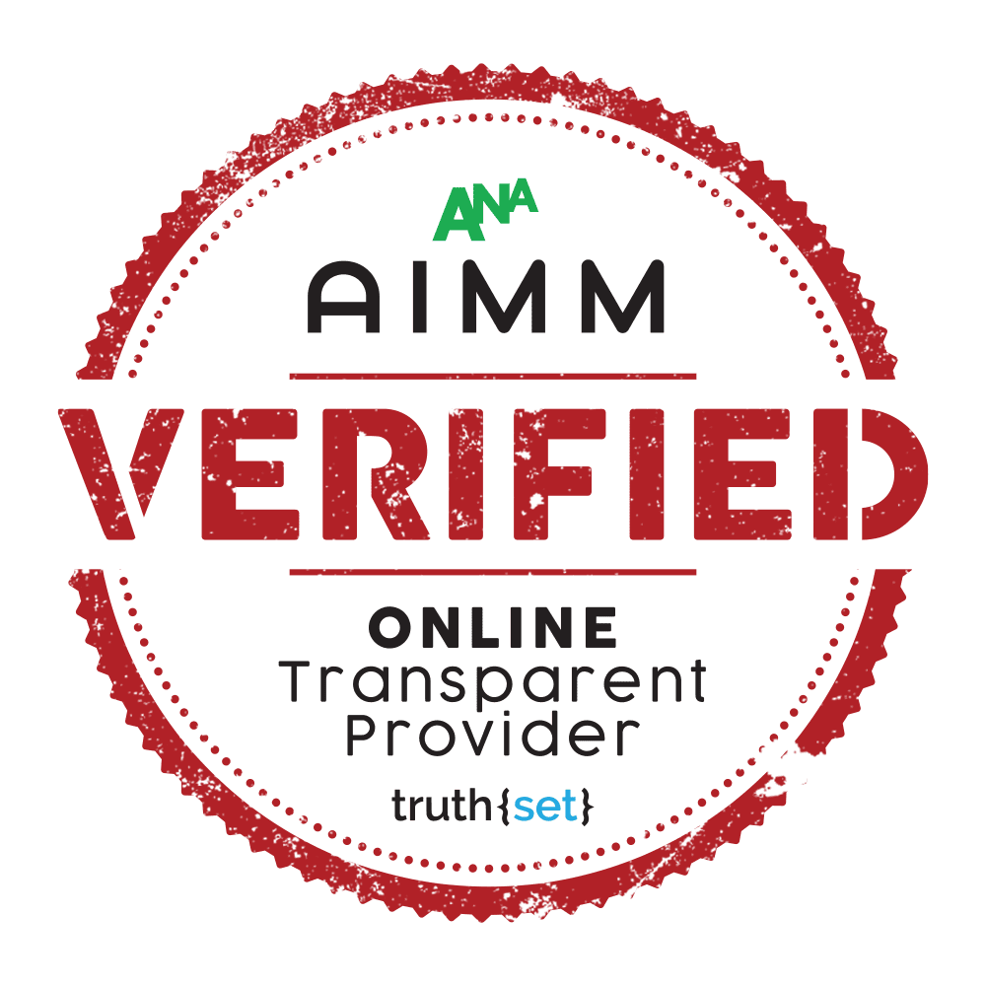
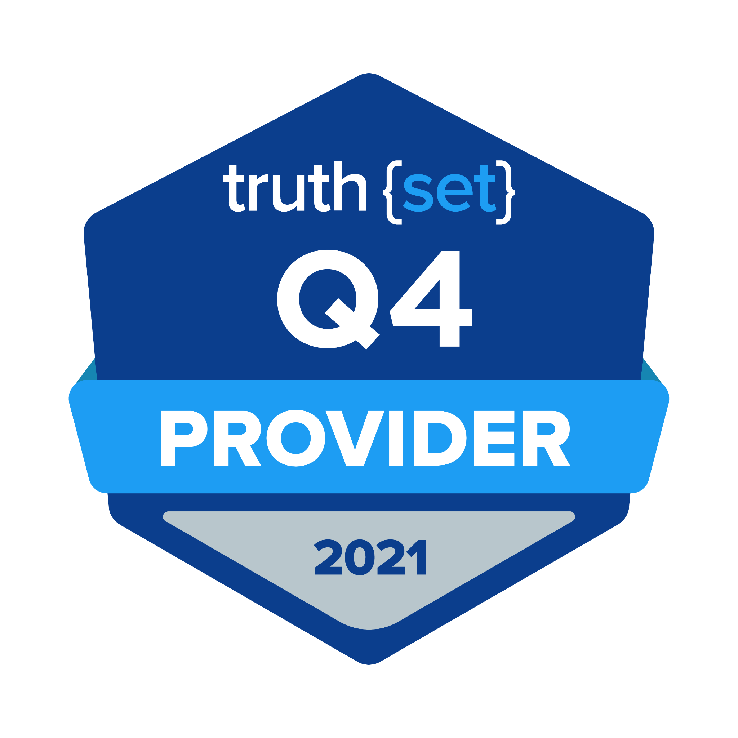
Top Ranked Consumer Audience Data
We outpaced our competitors in a study by Truth{set}, an independent firm that measures the quality of consumer audience data.
Hispanic Ethnicity
Household Income
Presence of Children
Luxury Car Owner
Political Affiliation
Our data is accurate, timely, and complete in many widely used consumer attributes, including:
Age
Gender
Military Status
Pet Owner
Notes:
100% verified consumer data
All fully legal and opt in base
Each quarter, truthset evaluates 12+ data companies
Our data quality is our differentiator.
We take tremendous pride in our consumer audience data, not only because this is what our company is built on but because it helps marketers perform better and save money. We ensure their ads reach the people who are interested in buying their products or hearing their message every time.

Slide 19
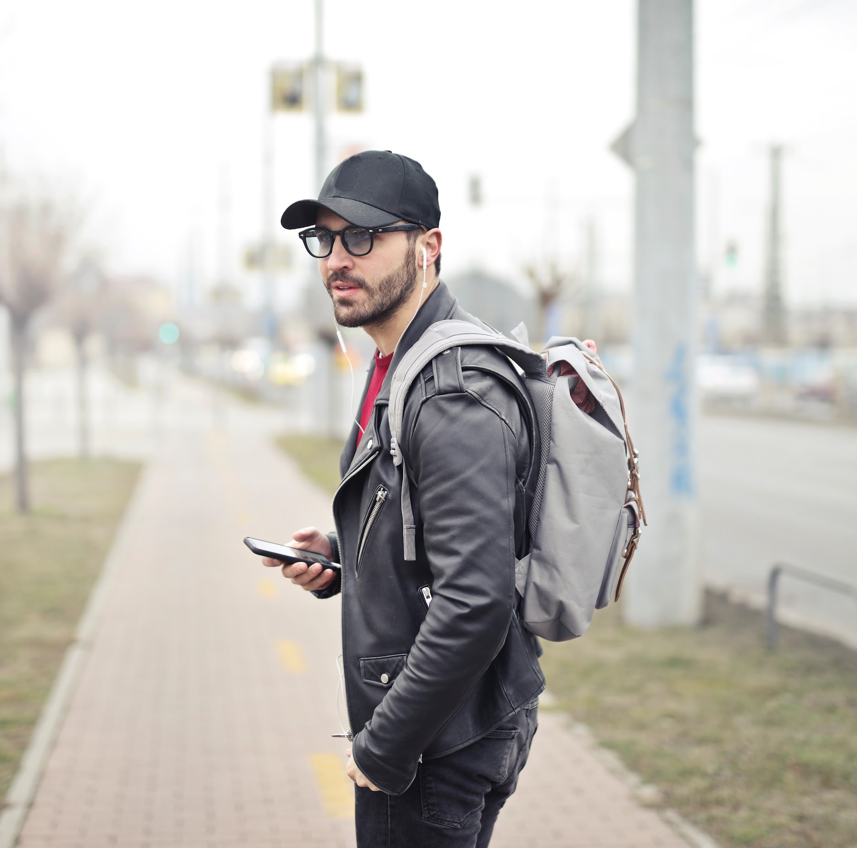
CASE STUDY | RETAIL
Use Case: Targeting Campaign
Iconic Clothing Company
The Challenge
Our Approach
An iconic clothing company was looking to maximize Video Completion Rate (VCR) and Click-Through Rate (CTR) performance. They were eager to test new media channels and different data providers for a more creative approach. The retailer turned to our powerful data to drive sales.
We took the initial request of identifying individuals who are fans of the Emmys and used our experience in audience creation to determine the attributes that make up that specific audience. The custom segment included men ages 18-25 and women 55+ who had an interest in performance and television.
Success
Custom Audience Solution
Post-campaign reporting showed that our mobile-first data was a top performer against other partner segments that the clothing company targeted within this campaign.
We utilized our custom audience solution to help this iconic clothing company drive greater ROAS (Return on Ad Spend) and exceed KPI goals.

Slide 20
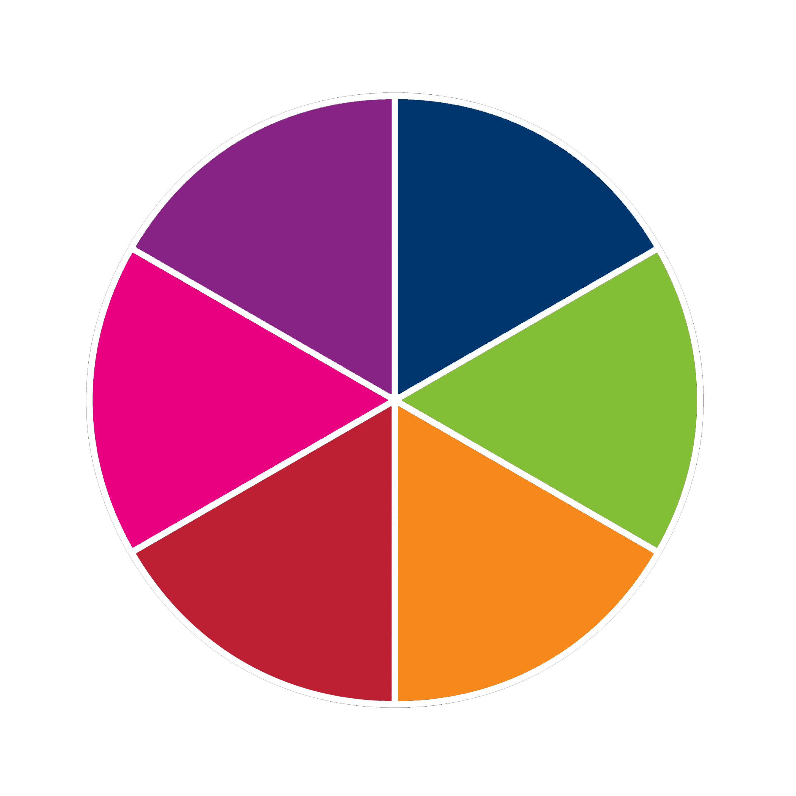
Iconic Clothing Company
Use Case: Targeting
We have the flexibility to use standard audiences built by our data experts or can create a unique and dynamic custom audience tailored to your client’s KPI goals.
ONBOARDING
CONQUEST
HEALTH
CARE
FSI
Why it matters:
Our data can be used across multiple verticals and a variety of data use cases.
We can pair any vertical case study with a data use case that is specifically tailored to a client’s data needs.
Contact us to get started with your custom audience solution.
DATA LICENSING
AUTO
GLOBAL
FILL IN THE GAPS
CPG
TRAVEL
TARGETING
RETENTION

Slide 21
CASE STUDY | GLOBAL
Use Case: Filling In The Gaps In 1st Party Data
Audio Streaming Platform
The Challenge
Our Approach
An audio streaming platform company wanted to fill in the gaps in their data with good, quality, and at-scale international data. They recognized our international data scale and quality and reached out to us to acquire specific segments by country. The audio streaming platform company was interested in adding our attributes to a few of their existing segments.
Using actual, verified and GDPR compliant customer profiles, we were able to amplify the audio streaming company’s global audience scale. We identified MAIDs requested from specific countries including: Germany, UK, France and have since added Spain and Italy. The audio streaming company was able to layer the country specific segments with the international segments to create custom segments by country.
Success
The audio streaming company chose us instead of using their own data as they typically do. They decided to partner with us to increase their international audience scale. They valued our GDPR-compliant 3rd party data against others and used it to fill in the gaps of their global customers.

Slide 22
Audio Streaming Platform
Use Case: Filling In The Gaps In 1st Party Data
We fill in the gaps of your audience knowledge by providing additional characteristics, more scale, or an entirely new dataset, giving you a full view of your ideal audience.
ONBOARDING
CONQUEST
HEALTH
CARE
FSI
Why it matters:
Our data can be used across multiple verticals and a variety of data use cases.
We can pair any vertical case study with a data use case that is specifically tailored to a client’s data needs.
Contact us to get started with your custom audience solution.
DATA LICENSING
AUTO
GLOBAL
FILL IN THE GAPS
CPG
TRAVEL
TARGETING
RETENTION

Slide 23
CASE STUDY | HEALTHCARE
Use Case: Onboarding
Mobile Health Data
The Challenge
Our Approach
A major American Spanish broadcast television network, was previously relying on Crossix as their leading healthcare data provider. To further expand their data accuracy and targeting, the client partnered with our to identify Hispanic adults diagnosed with diabetes.
Based on our rich database of demographics, mobile behaviors, app usage, app downloads and purchase behaviors, we built a custom health audience for the major network to increase their customer base and deliver media to their ideal consumers.
Success
Crossix, a leading healthcare analytics and data solutions company, provided reporting on the performance of our custom audience. The reports showed that our mobile-first health data outperformed all other segments provided by the network's top health data partners with increased precision, accuracy and high-quality customers.
Since implementing our custom health data into their marketing efforts, our client is continuing to leverage a week-over-week increase in both mobile and desktop engagement.

Slide 24
Mobile Health Data
Use Case: Onboarding
We connect identifiers (name, postal email, MAID, IP, PHONE #) from different data sources (SDK, BATCH, API) to build a complete picture of an actual, verified individual. This process activates opportunities for multi-channel campaigns.
ONBOARDING
CONQUEST
HEALTH
CARE
FSI
DATA LICENSING
AUTO
GLOBAL
FILL IN THE GAPS
Why it matters:
Our data can be used across multiple verticals and a variety of data use cases.
We can pair any vertical case study with a data use case that is specifically tailored to a client’s data needs.
Contact us to get started with your custom audience solution.
CPG
TRAVEL
TARGETING
RETENTION

Slide 25
Appendix:
Media Delivery Solutions & Case Studies
‹#›

Slide 26
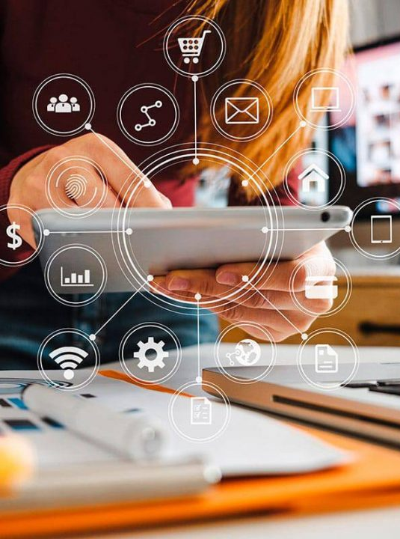
Programmatic Buying
We purchase media on premium inventory through a range of deal types such as: open marketplace RTB, PMP, and preferred deals
Full-funnel strategies support campaign objectives such as brand awareness, lead generation and purchase or conversion
We purchase media programmatically across verticals: Auto, Home & Garden, Health & Fitness, Business, Education, Hobbies & Interests, Food & Drink
Examples of goal types supported: CTR, VCR, reach, CPA, viewability

Slide 27
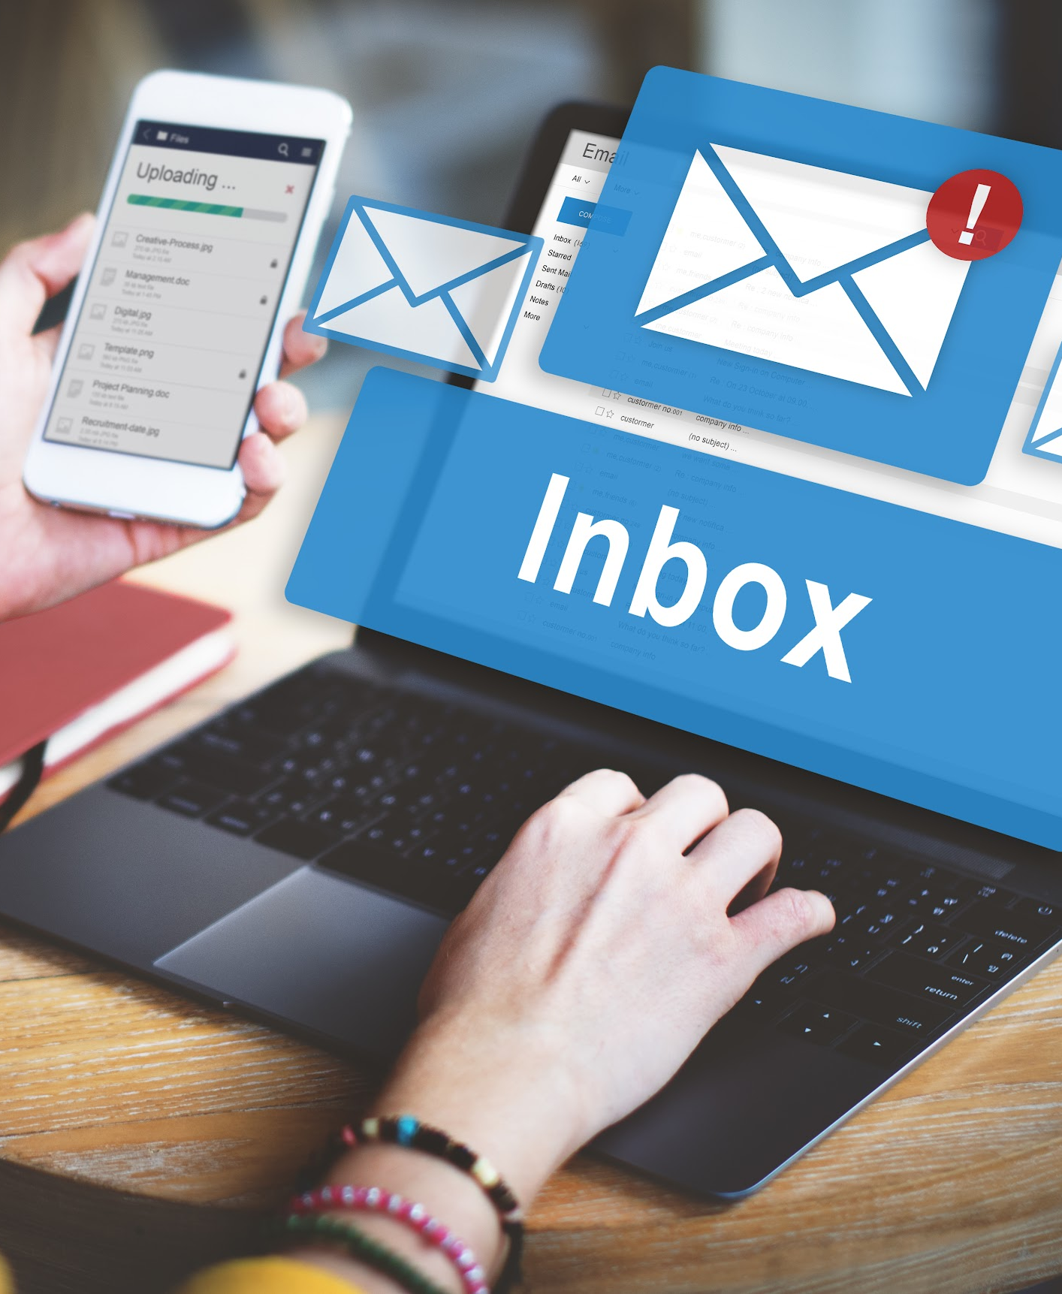
Email Marketing
Enables advertisers to send marketing messages to consumers via email. Our hygiene and verification process ensures your email is only sent to real email addresses.
Benefits:
Cost effective
Allows advertisers to send personalized messages to qualified audiences
Easy to track performance and optimize campaigns with real-time open rates, click-through rates and conversion rates
Can be accessed from any computer or device

Slide 28
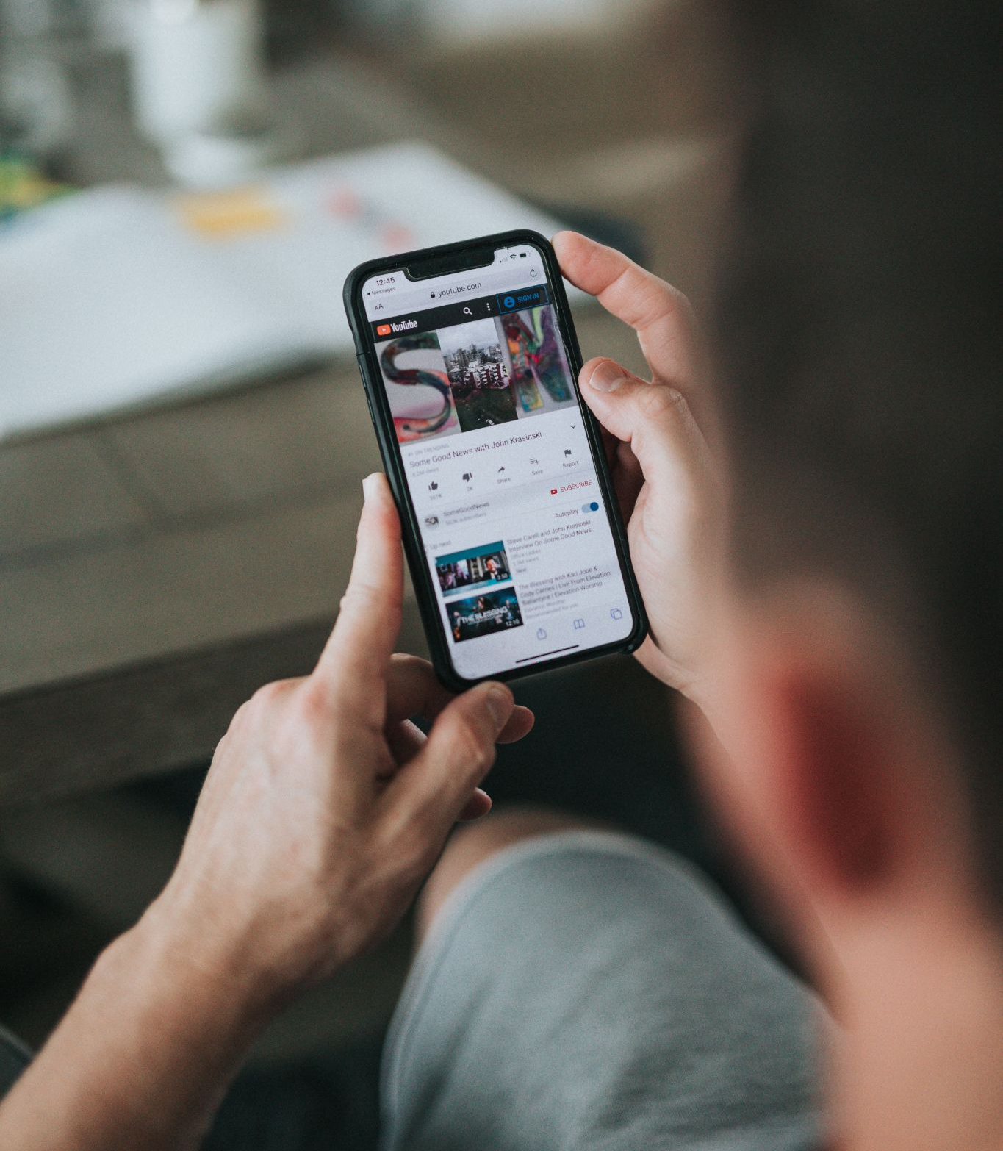
Display Advertising
Ads that are served on websites, apps or social media through banners or formats made of text, images, flash, video, and audio.
Benefits:
Reach a large quantity of people at once
Our audiences ensure that only real people who would be interested in your display ads see them

Slide 29
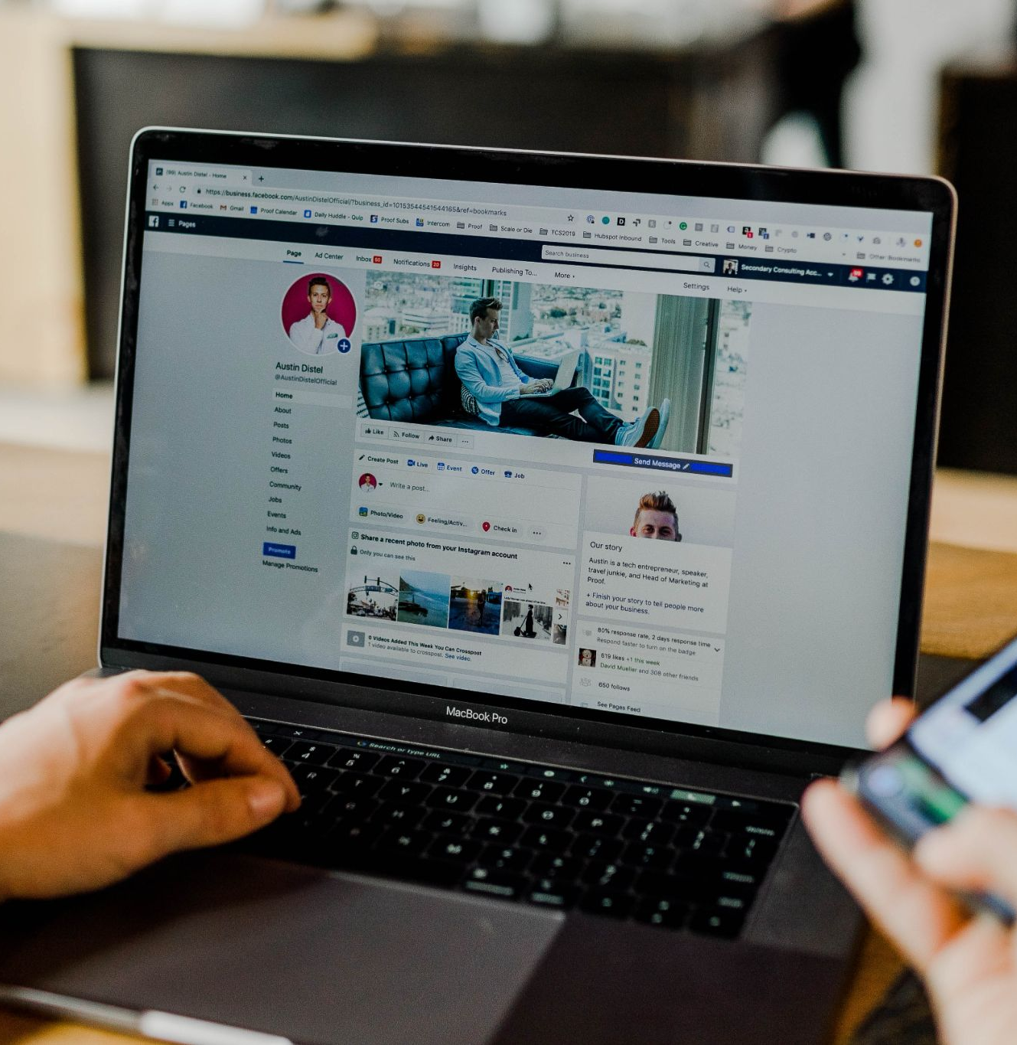
Social Media Advertising
Ads are served in the main feeds of the targeted consumers’ Facebook and/or Instagram pages. When clicked, consumers are taken to a landing page or website, NOT to the advertiser’s Facebook or Instagram page.
We will share your message with our first party audiences of real people as they browse Facebook and/or Instagram.
Note: clients must have a Facebook account to serve ads on Facebook or Instagram.
Notes:
To keep placement quality high, we do not serve ads in the right-hand rail, Facebook Messenger, Facebook Marketplace, or Facebook’s Audience Network.

Slide 30
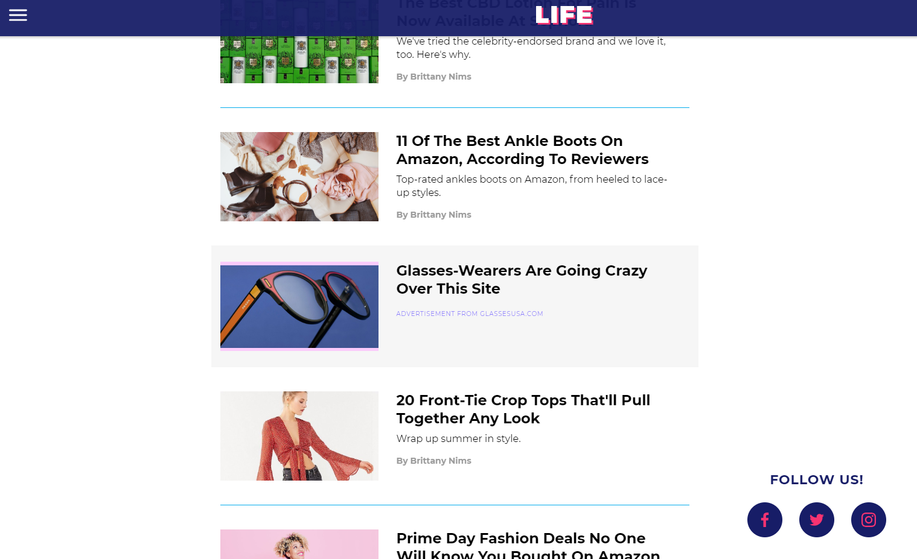
Native Advertising
Ads are served on desktop and mobile sites within the site’s organic content. These ads are placed to appear as a natural part of the website’s content.
Native ads are generally marked ‘Sponsored’ or ‘Promoted’ to differentiate it from the site’s organic content.

Slide 31
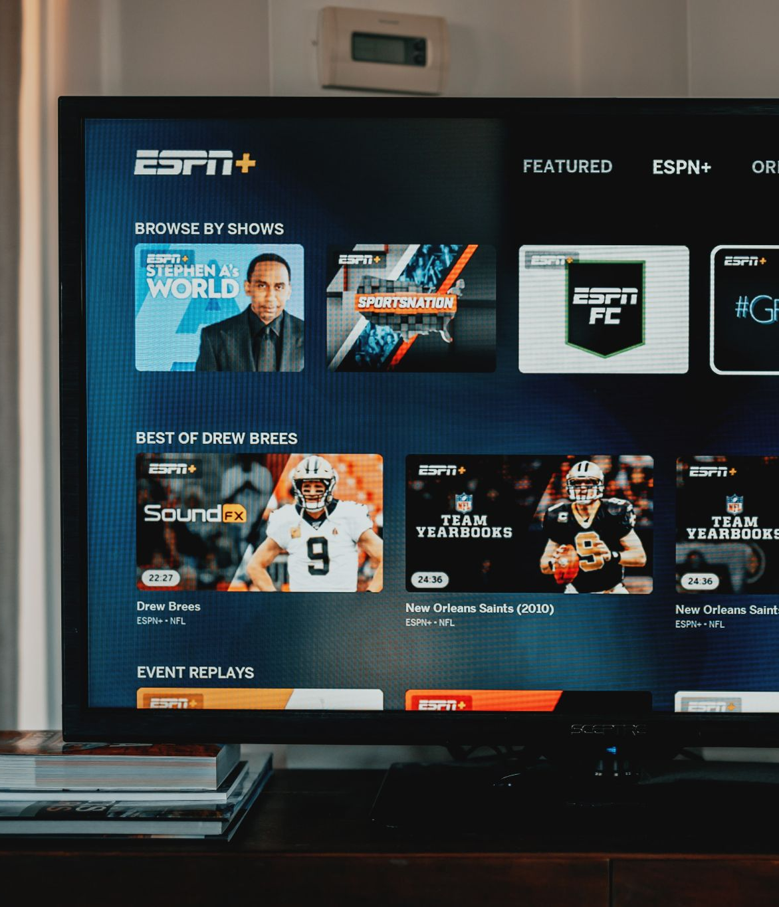
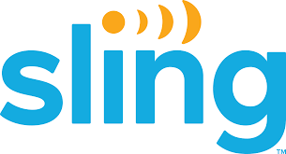
Connected TV and OTT
Your connected TV and OTT ads will be shown to your audience on a number of devices, channels and environments such as live streamed content, video-on-demand and full episode players.
Benefits:
High Visibility: Achieves high viewability and a 90%+ completion rate on premium display and mobile inventory.
Boost Brand Awareness: Guaranteed brand exposure since ads must play in their entirety.
Increase Conversion Rates: OTT media ads can be clickable to provide deeper insights and reporting.
Precise Audience Targeting: More visibility into what’s being watched, who’s watching and on what device.
Examples of where your CTV & OTT ads reach your customers:

Slide 32
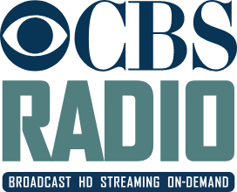
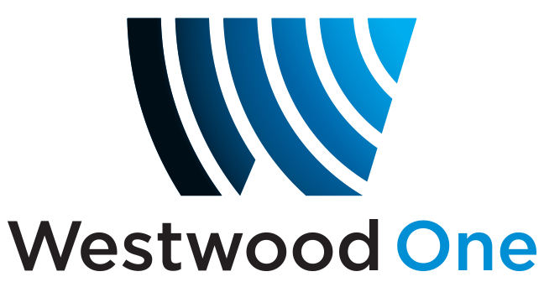
Programmatic Audio
Your audio ads will be delivered to your target audience through digital audio streaming apps, music, news, and podcasts.
Audio ads can be used target and retarget specific audiences based on geographic locations, time slots, interests and media preferences and can be run alone or alongside companion banners at no additional cost.
Further, retarget people who have listened to your ad to increase your conversion rates.
Examples of where programmatic audio reaches your customers:

Slide 33
Cannabis & CBD Campaigns
Benefits of Cannabis & CBD Campaigns: Safety and compliance Offer your product to mainstream audiences in a compliant way. We link online data to offline data at the individual level to ensure your cannabis and CBD ads are only reaching your target audience — and no one else. Deliver your message to REAL people legally on a wide variety of general interest sites via the following media channels:
Web & mobile display
Mobile in-app display
Pre-roll video display (web & mobile)
Connected TV
Brand Awareness Guaranteed brand exposure since ads reach real people where they engage most.
Transparent Reporting
People-based reporting gives you full transparency into your Cannabis or CBD campaign performance including attribution such as dispensary visits. This enables you to make informed decisions about your campaign.
We will manage your cannabis & CBD campaign from end-to-end from creating a custom audience of real people, delivering the media, optimizing the campaign, and providing detailed reporting and analytics.
*Note: Each state has its own guidelines and creative requirements for cannabis marketing. Please reach out to your Account Manager for additional information.

Slide 34
TikTok Advertising
Reach new audiences and bring your brand back to life on TikTok, one of today’s hottest social media channels with over 130M active US users.
These are not generic TikTok audiences. These are REAL people. Build a custom audience with our #1 ranked data and reach them with your ad.
Ads are served in the ‘For You’ page of the targeted consumers feed on TikTok. When clicked, consumers are taken to advertiser’s TikTok page or website.
We will tell you who your ads are reaching. You'll see what's working, and you'll get miles more from your ad spend.
Note: Advertisers do not need a TikTok account. Similar to display campaigns, we direct the user to click on the URL.

Slide 35
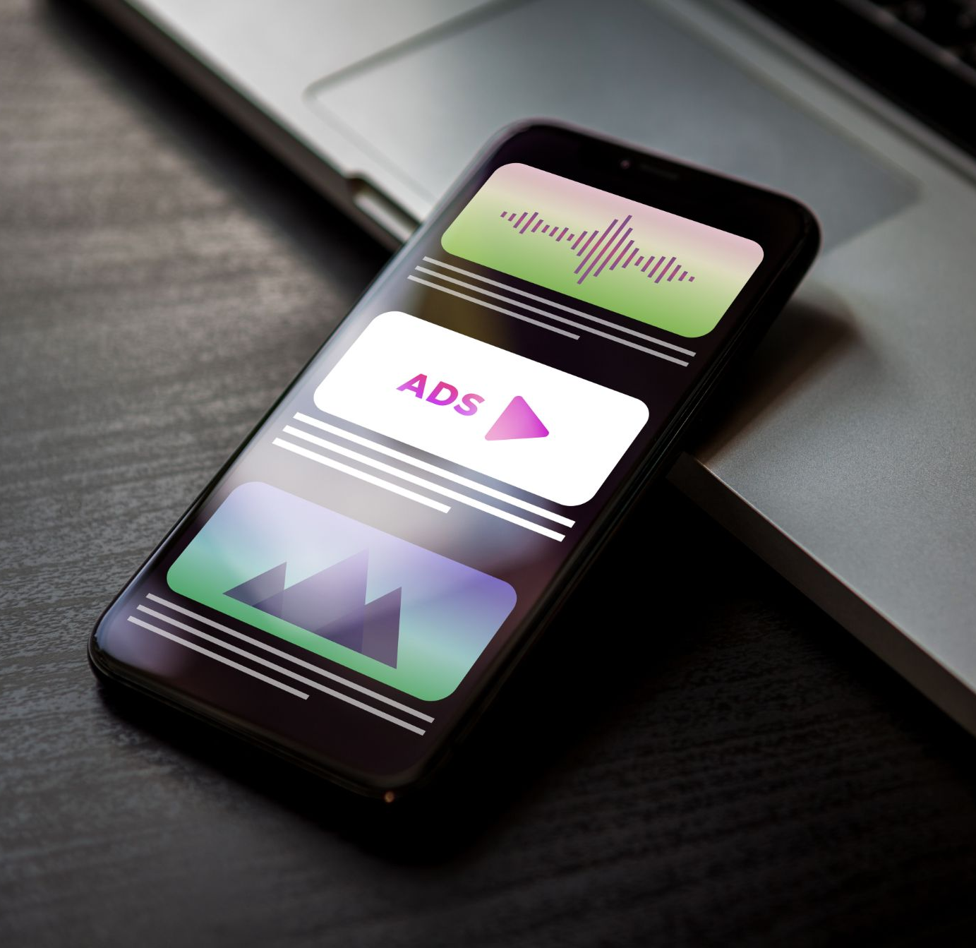
Third Party Ad Serving
We have the flexibility to work with the majority of third party ad servers. In general, we can support any ad server that follows the IAB Measurement Guidelines. Please reach out to your account team for a comprehensive list third-party ad servers we support.
Ad servers not in our list may still be supported for your campaign - simply reach out to your Account Manager with a sample creative to test the creative and finalize the integration.

Slide 36
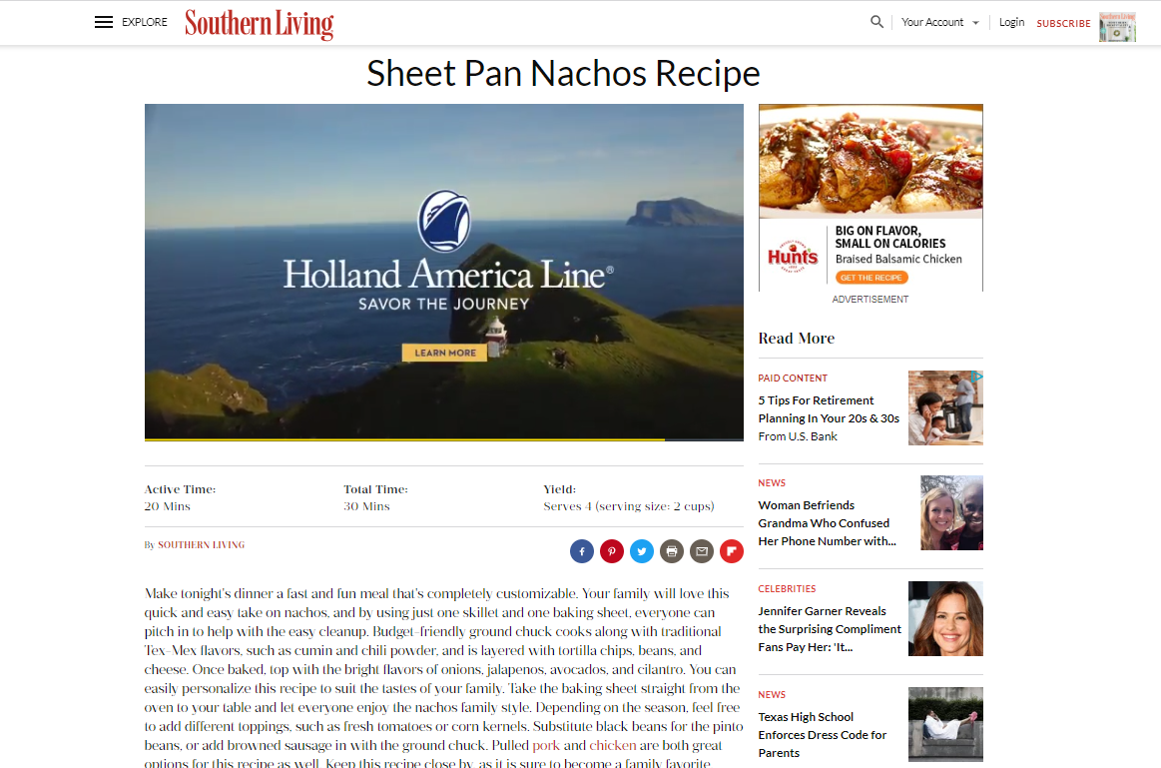
Video Pre-Roll
We will programmatically deliver your video pre-roll ads on desktop web, mobile bwe and apps that allow video ad content. Ads will appear before organic video content is shown to a consumer.
Video pre-roll can be run alone or alongside companion banners.

Slide 37
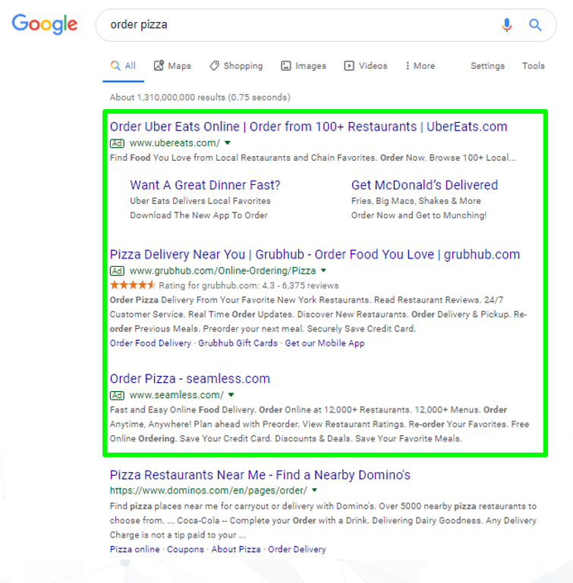
Paid Search / SEM
(aka Pay-Per-Click, PPC, Search Engine Marketing, AdWords, Google Ads) Serve ads on the Google’s search engine results page to highly-qualified consumers - those who have already made the decision that they need the product/service and have proactively searched for for it. You only pay after someone clicks on your ad.
Great for:
Budgets of over $3k/mo
Clients with high LTV (doctors, dentists, cable/internet, etc.)
Brands that offer a niche product or service
Customers looking to make big ticket purchases or pay a lot for a service (attorneys, appliances, home/auto repair, etc.)
Special or seasonal events (weddings, funerals, holidays, tourism, etc.)
Visuals for mockup purposes only.
Notes:
NOTES:
Advertisers only pay after someone clicks on the ad
SEM tends to have a higher price tag but generates high quality results
We use a Single Keyword Ad Group (SKAG) strategy, meaning we will write many more copy options than typical SEM companies, making your ads more specific and relevant to what the user is searching for. This often leads to higher ad placement in Google search results and ultimately more visibility to users
Unlike most SEM companies who use a broader approach,, we use a custom tiered zip-level geo strategy to ensure we are spending advertisers' budgets as efficiently as possible.

Slide 38
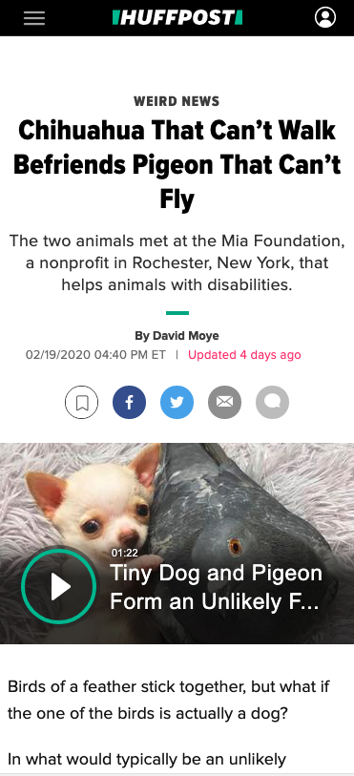
Geofencing
A digital boundary that is placed around a specific physical area. Consumers that enter the targeted area will receive ads. These ads are not served specifically to our first party audiences
Geofences can be as small as 20-meters in size
Ads are NOT pop-up / immediate ads. Ads may be served after consumers leave the targeted area, up to 30 days later
Ads could be served on desktop sites, mobile sites, or mobile apps
I recently shopped at a grocery store and how I’m seeing an ad within an app promoting a competing grocery store chain
Visuals for mockup purposes only.

Slide 39
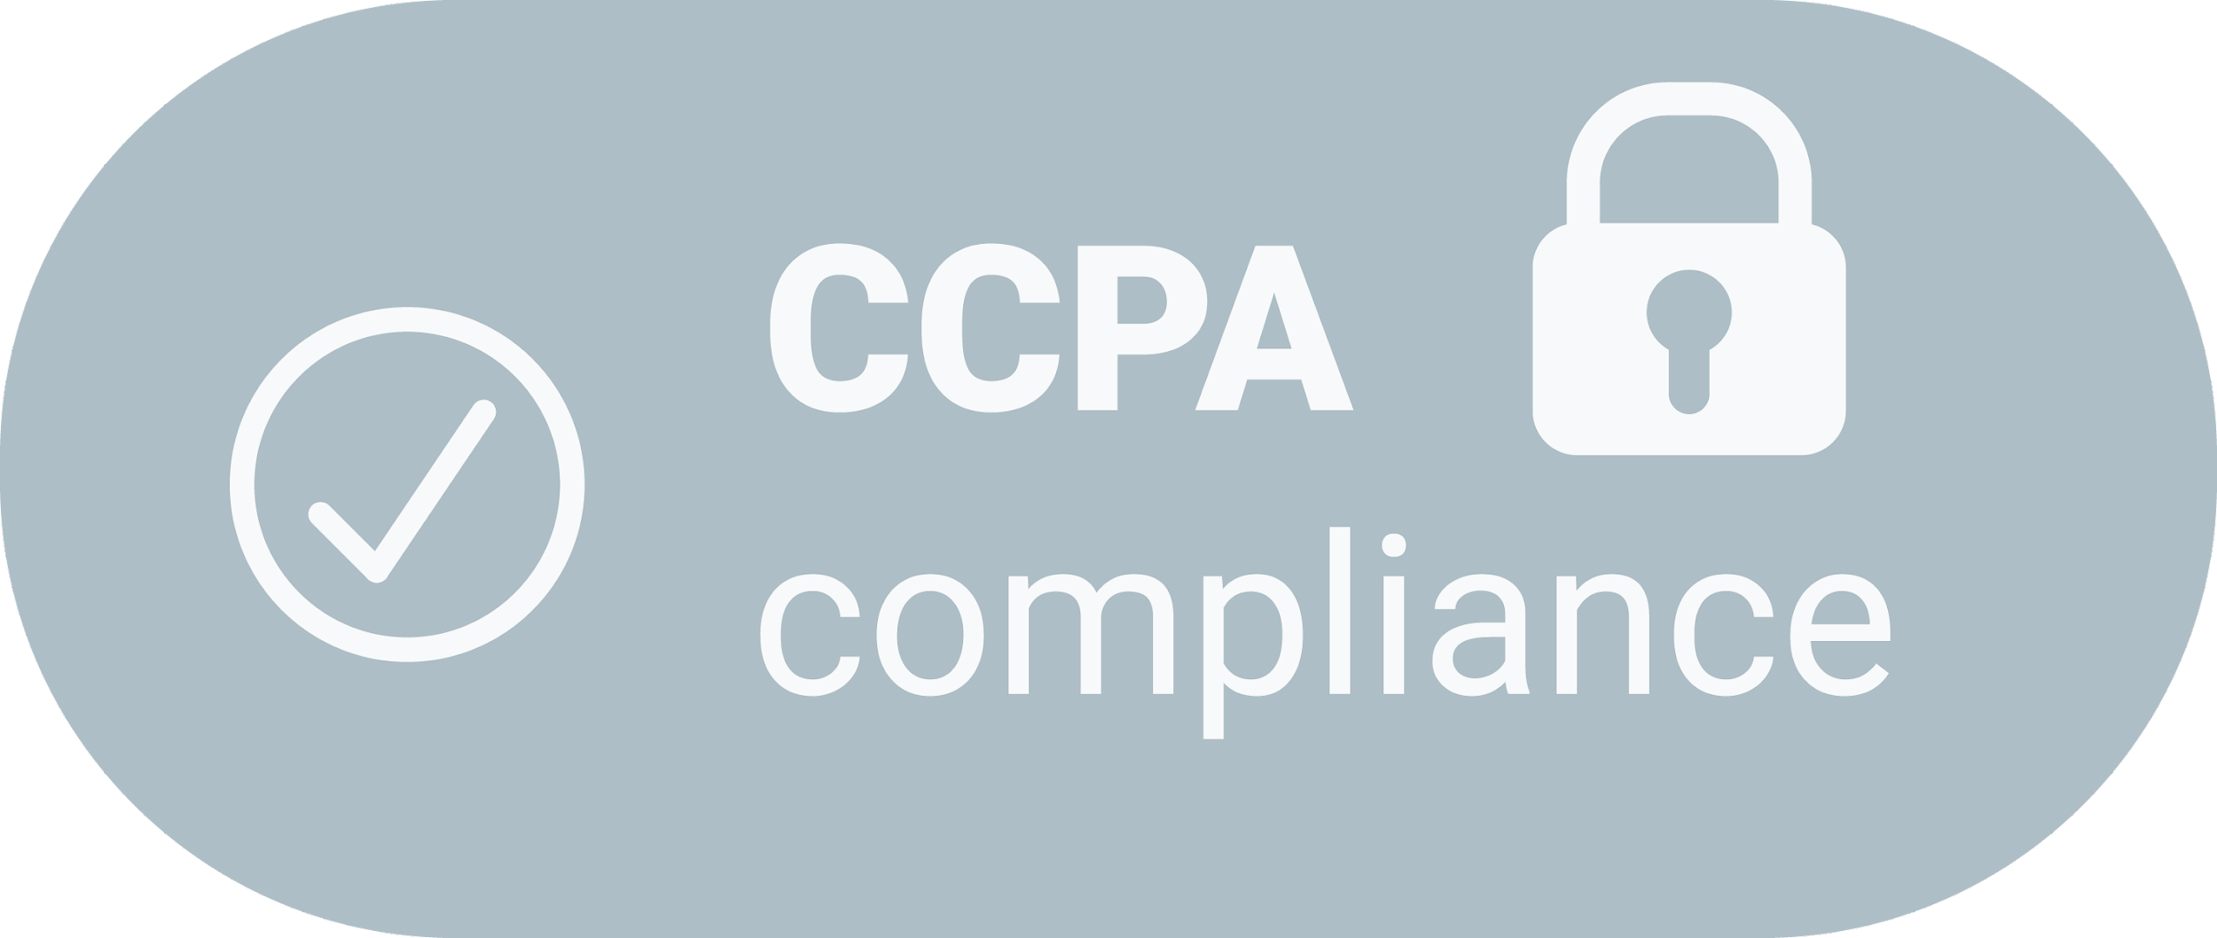
The California Consumer Privacy Act (CCPA)
All of our data is permission-based, ethically-sourced and CCPA and GDPR compliant. The California Consumer Privacy Act (CCPA) is a consumer privacy law that went into effect on January 1, 2020 that enhances privacy rights for California residents.
The CCPA requires additional actions by companies to protect consumers' rights including:
the right to opt-out of data collection
the right to know what personal information businesses collect about them
the right to have their information deleted from a company's database

Slide 40
General Data Protection Regulation (GDPR)
All of our data is permission-based, ethically-sourced and CCPA and GDPR compliant. Consumers choose to opt in and can opt out at any time.
The General Data Protection Regulation (GDPR) is regulation passed in the European Union (EU) on May 25th, 2018. GDPR is designed protect the privacy and personal data of EU citizens. we are 100% GDPR compliant:
Consumers who use applications in our mobile publisher network must consent to data collection via our End User License Agreement (EULA).
Our privacy policy clearly provides consumers with transparency into what data is being collected once a consumer opts in and how the data is used.

Slide 41
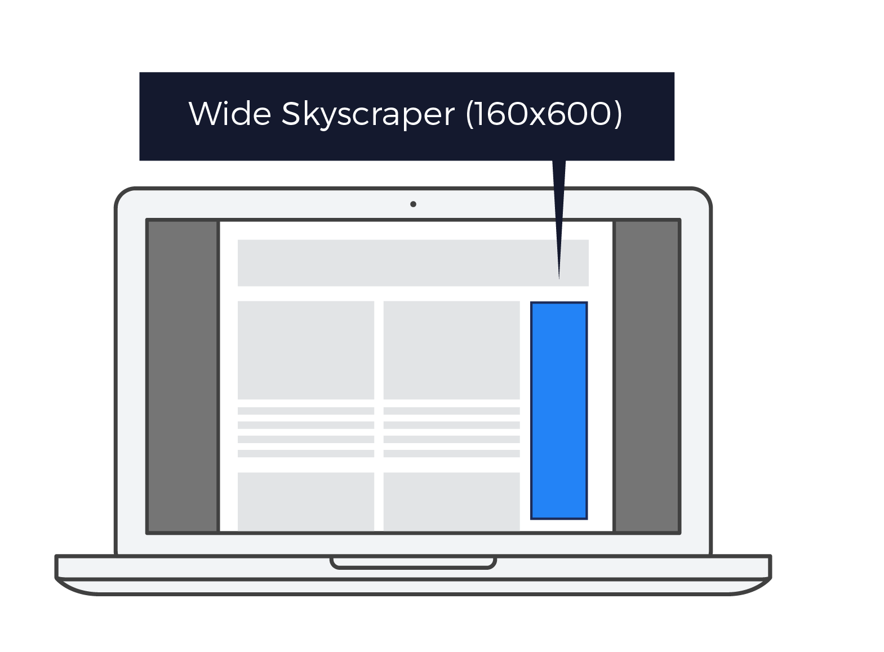
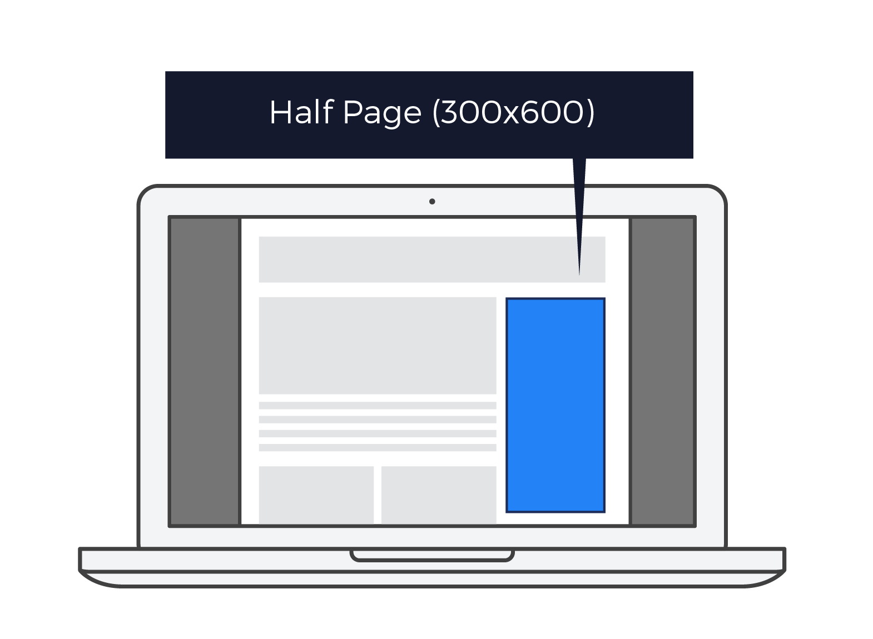
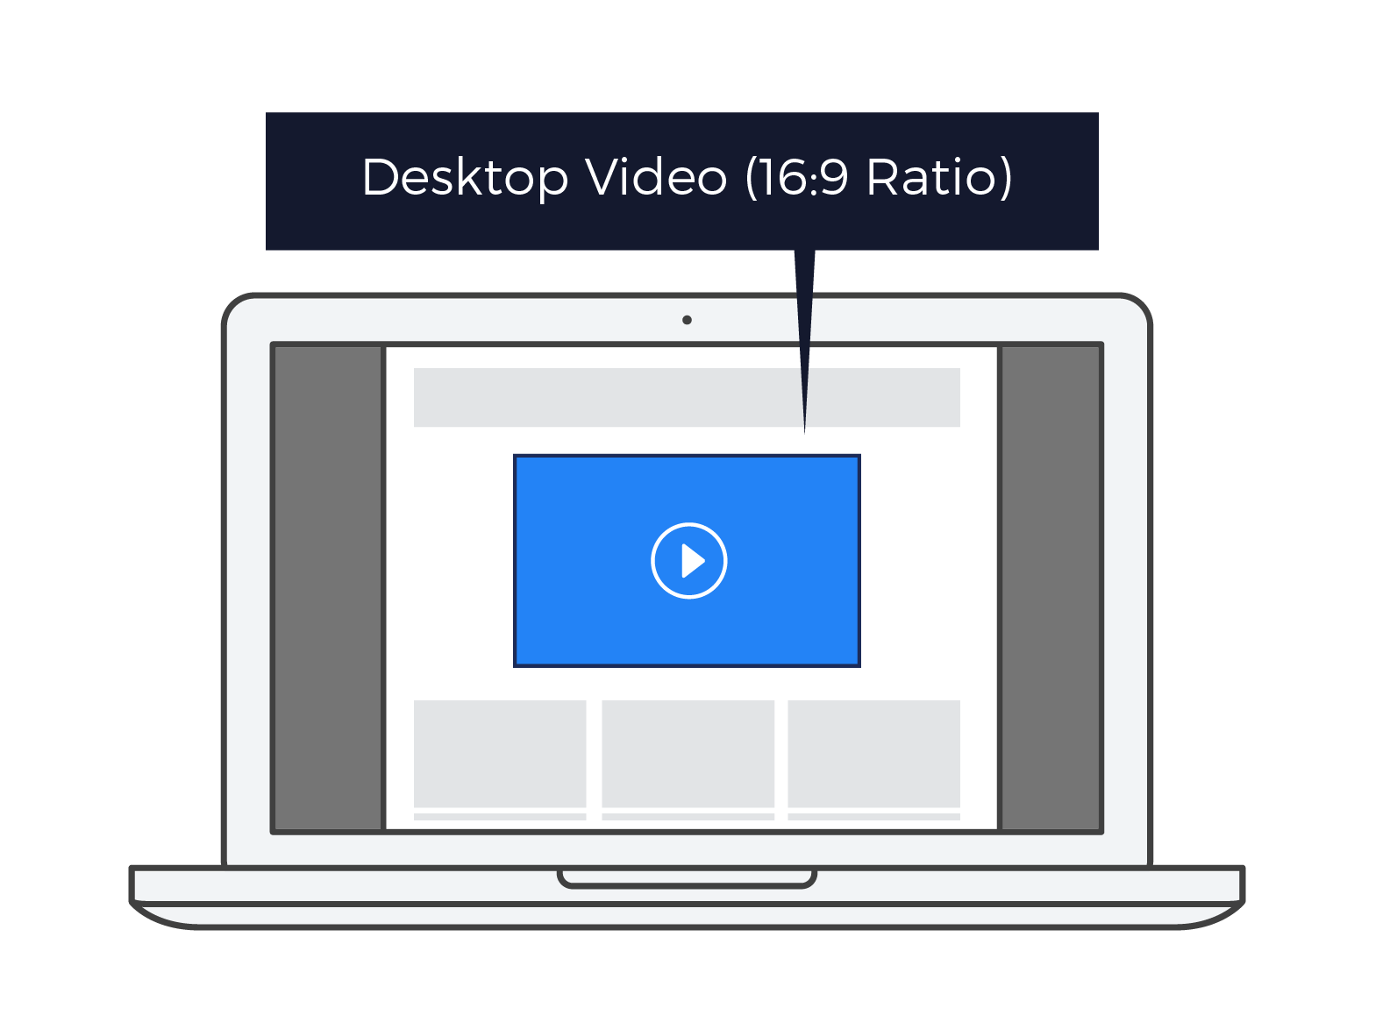
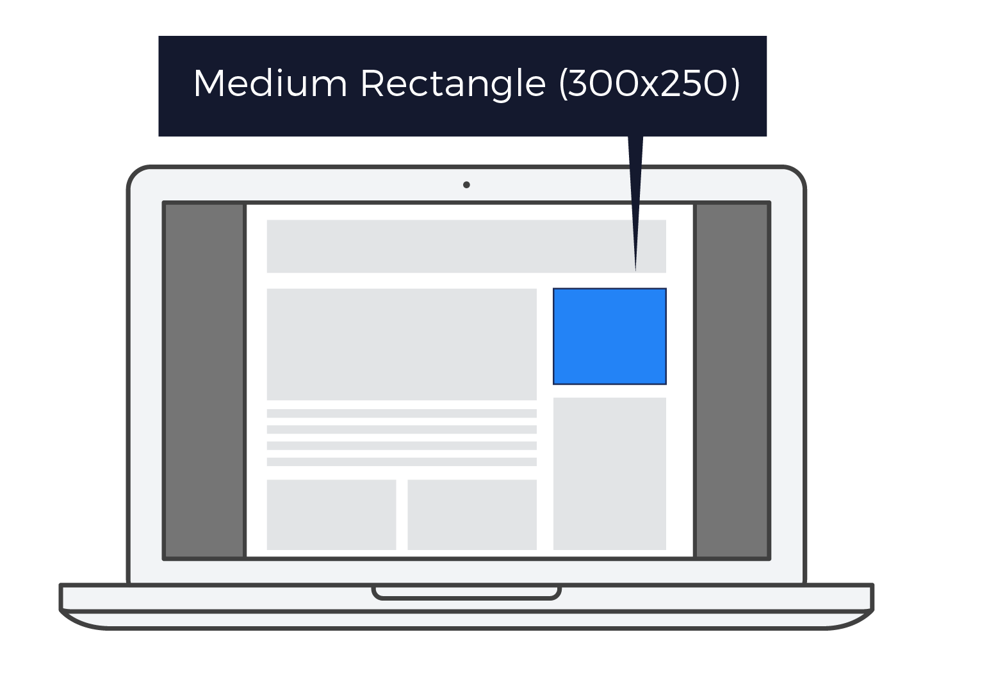
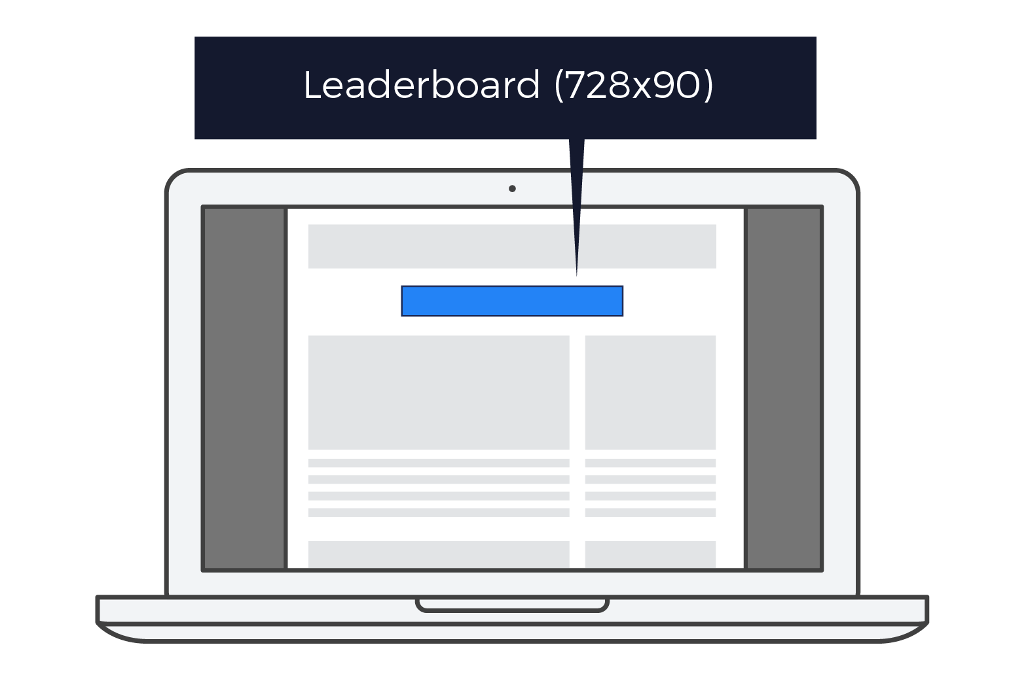
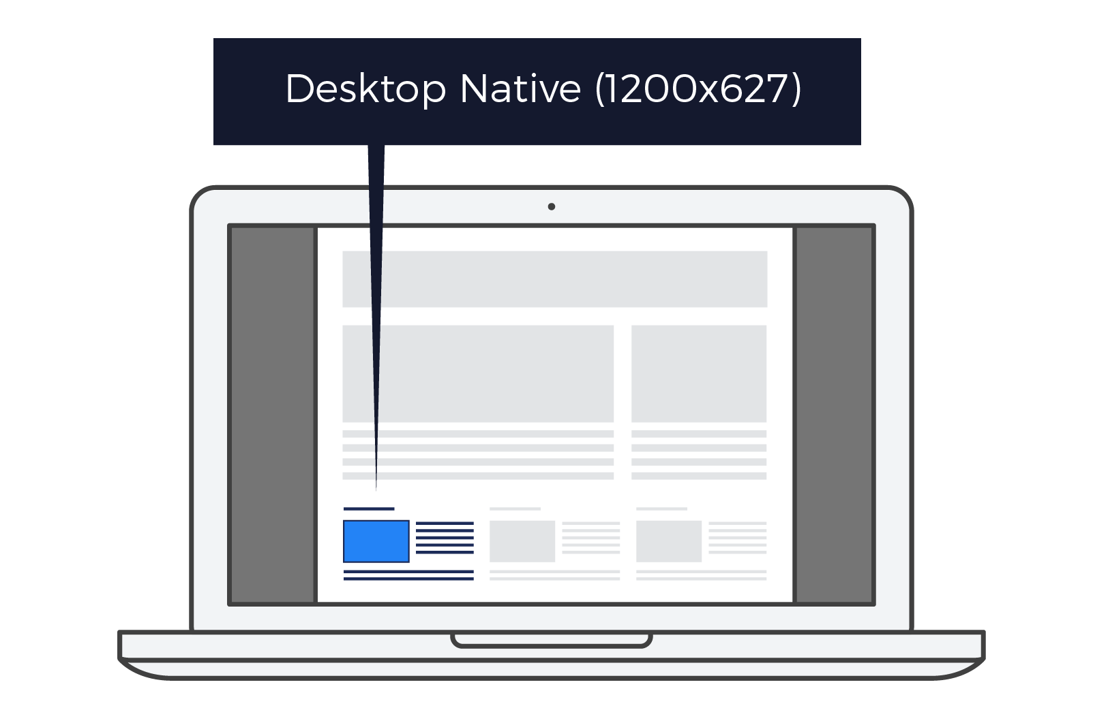
Display Ad Sizes
Desktop

Slide 42
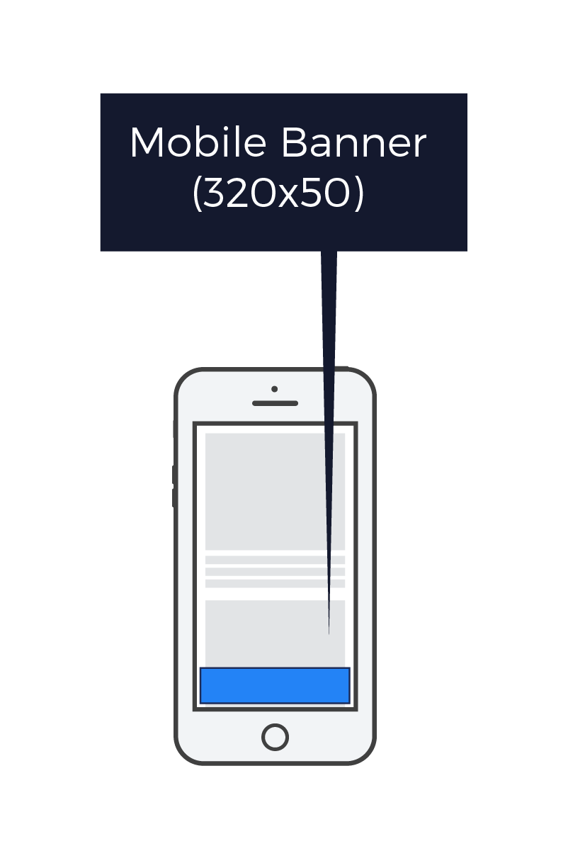
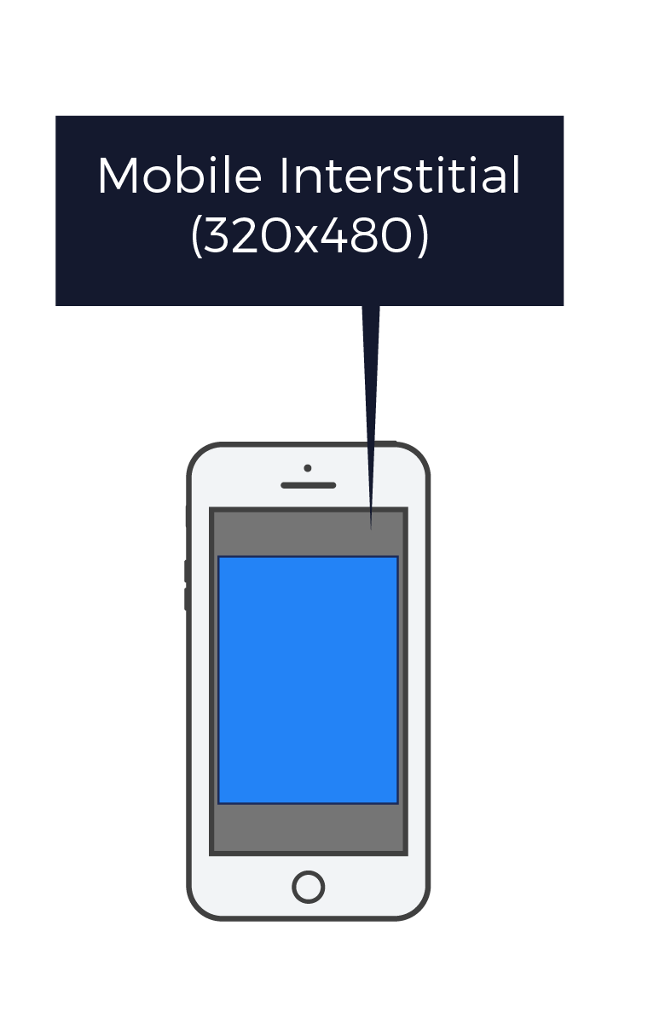
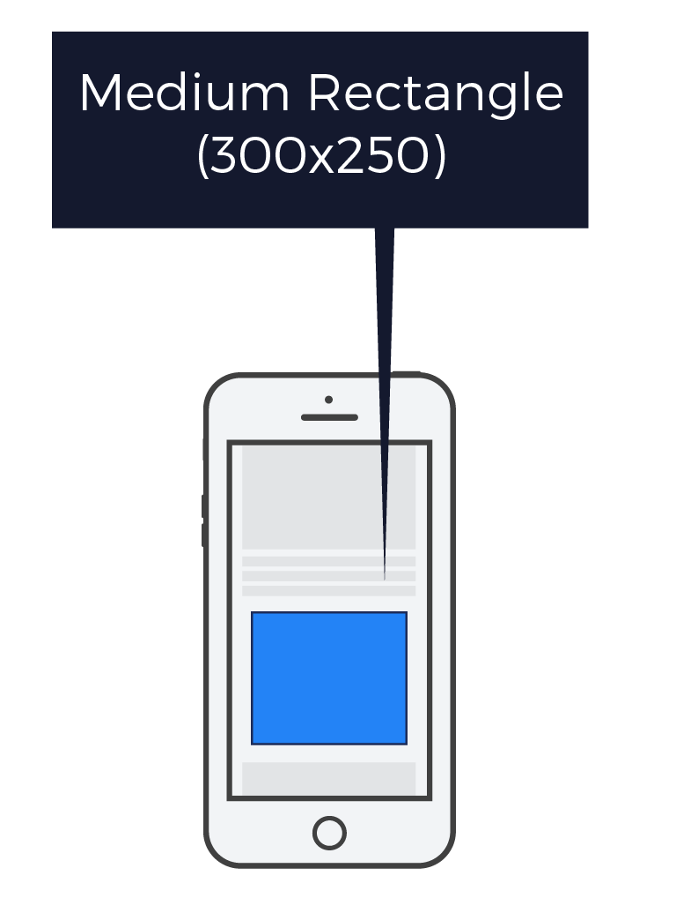
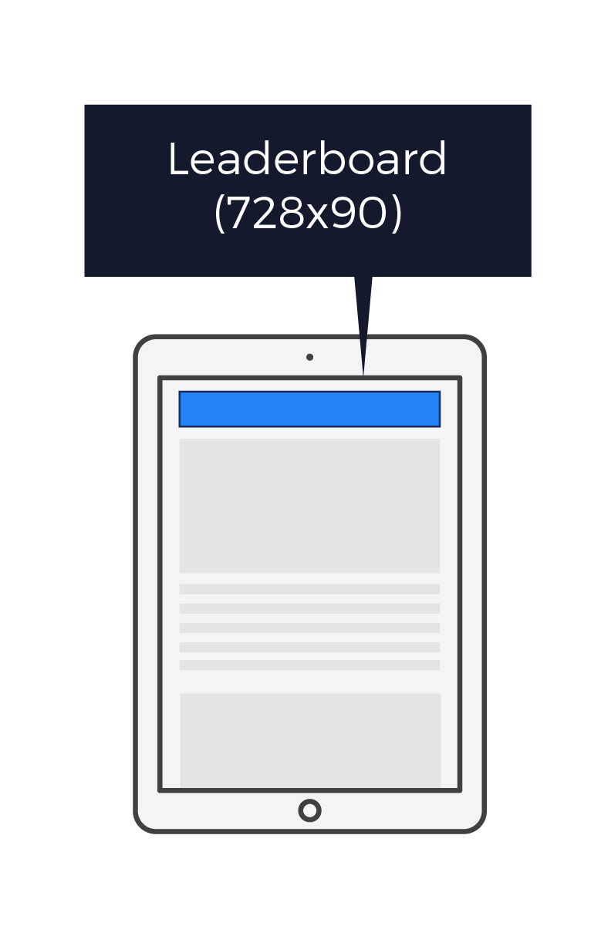
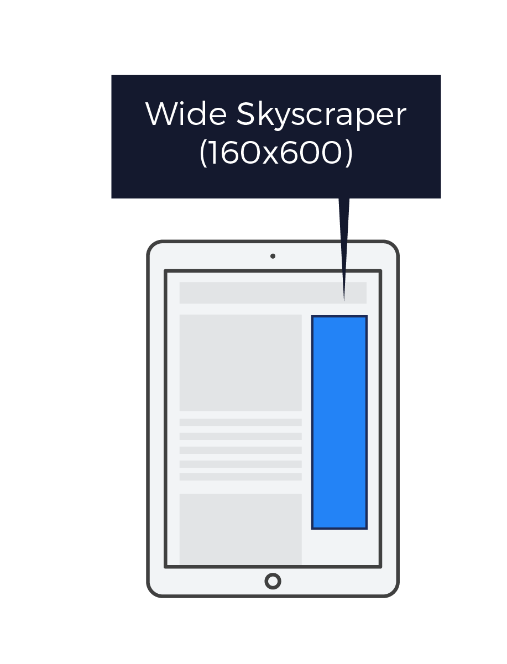
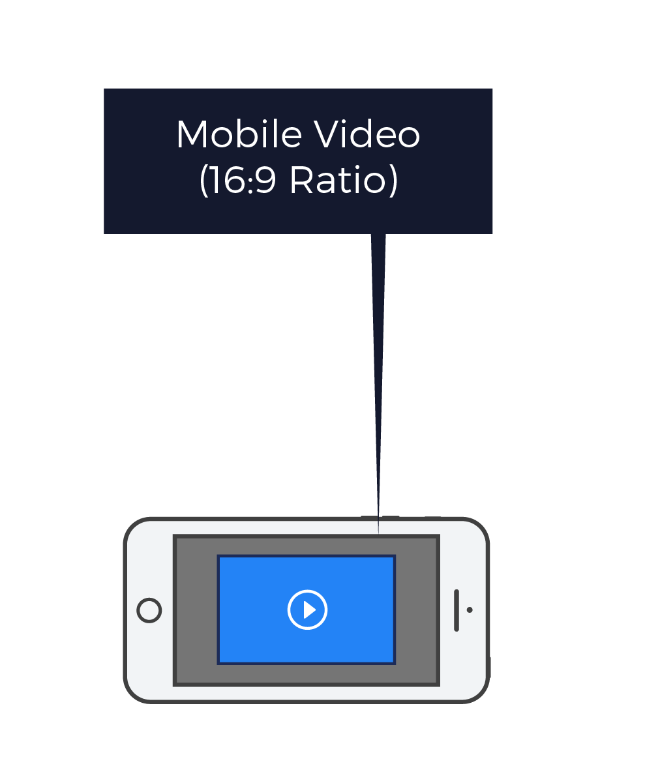
Display Ad Sizes
Mobile

Slide 43
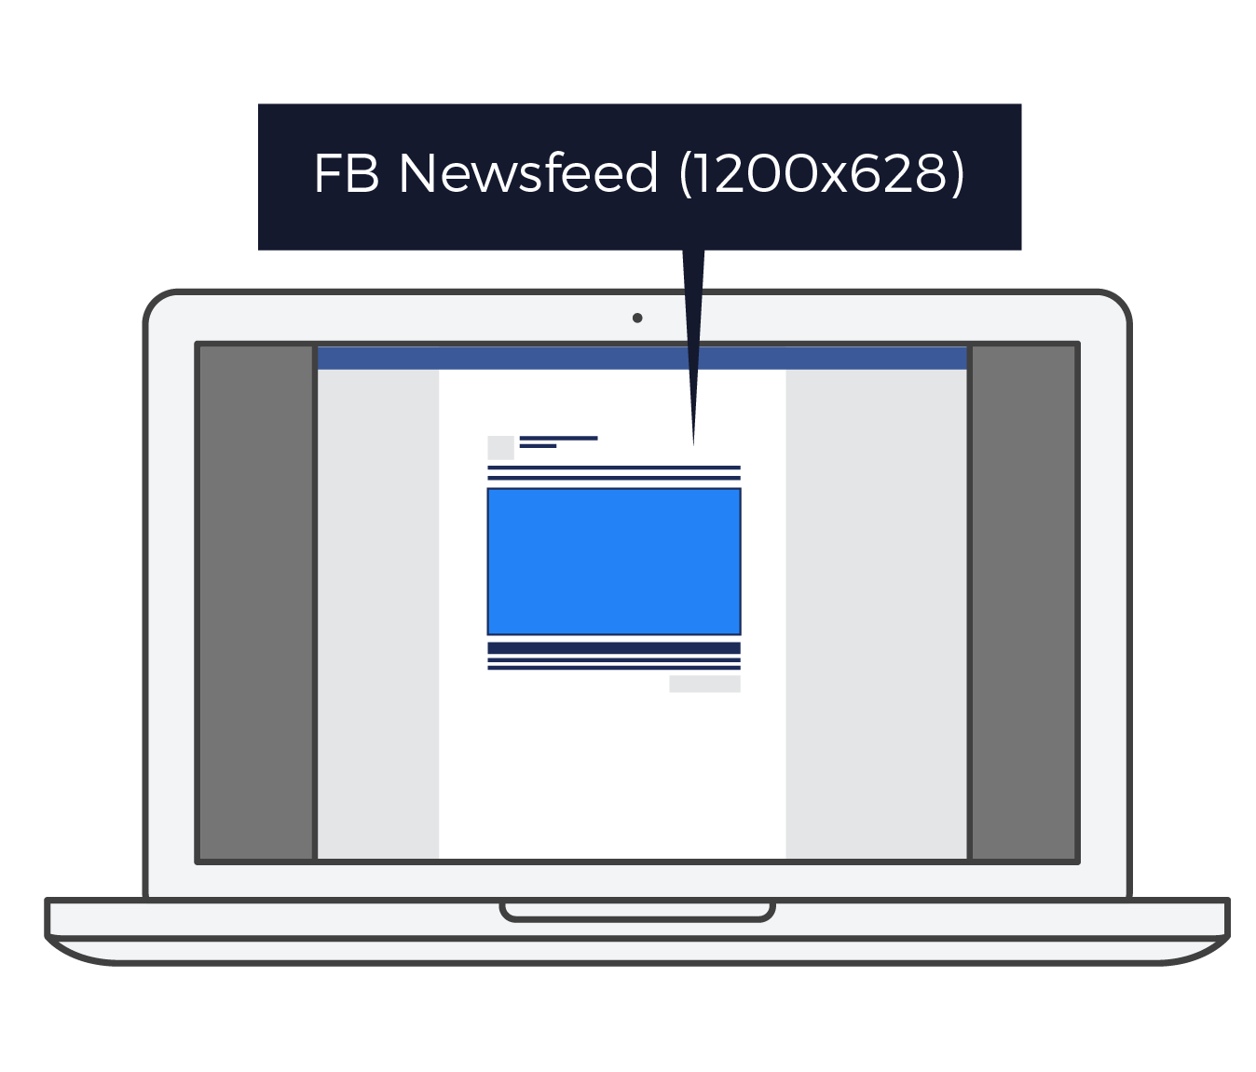
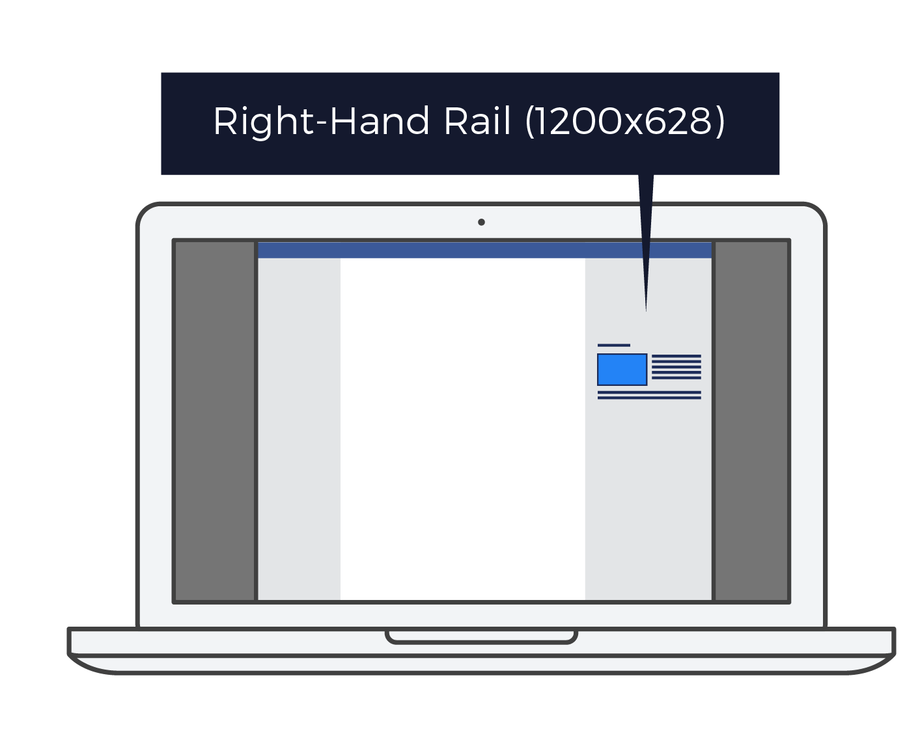
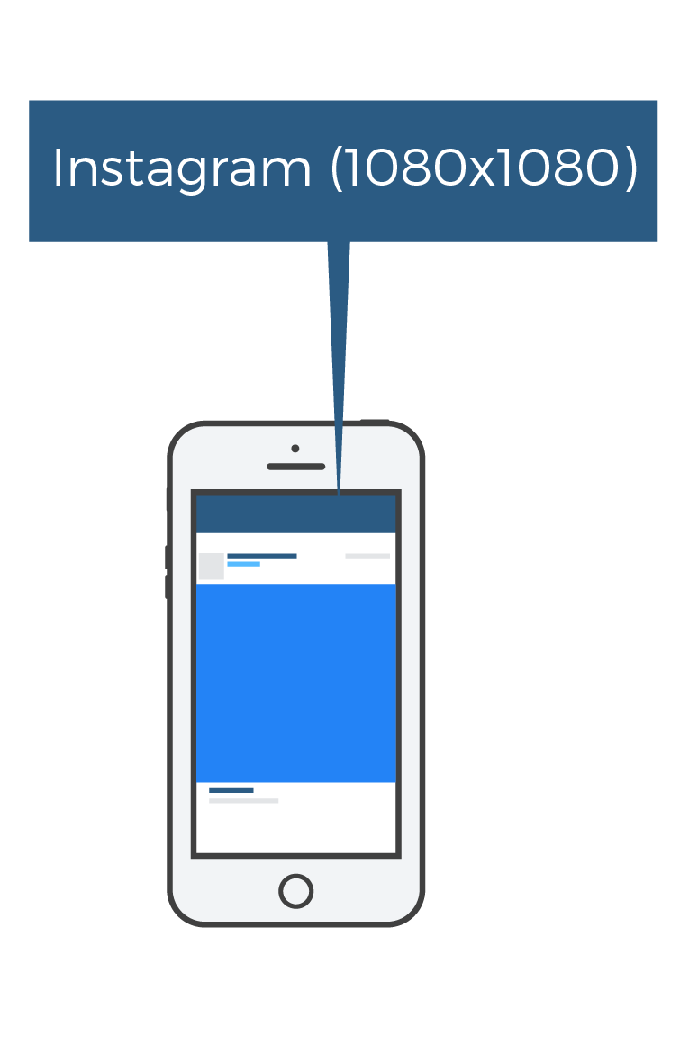
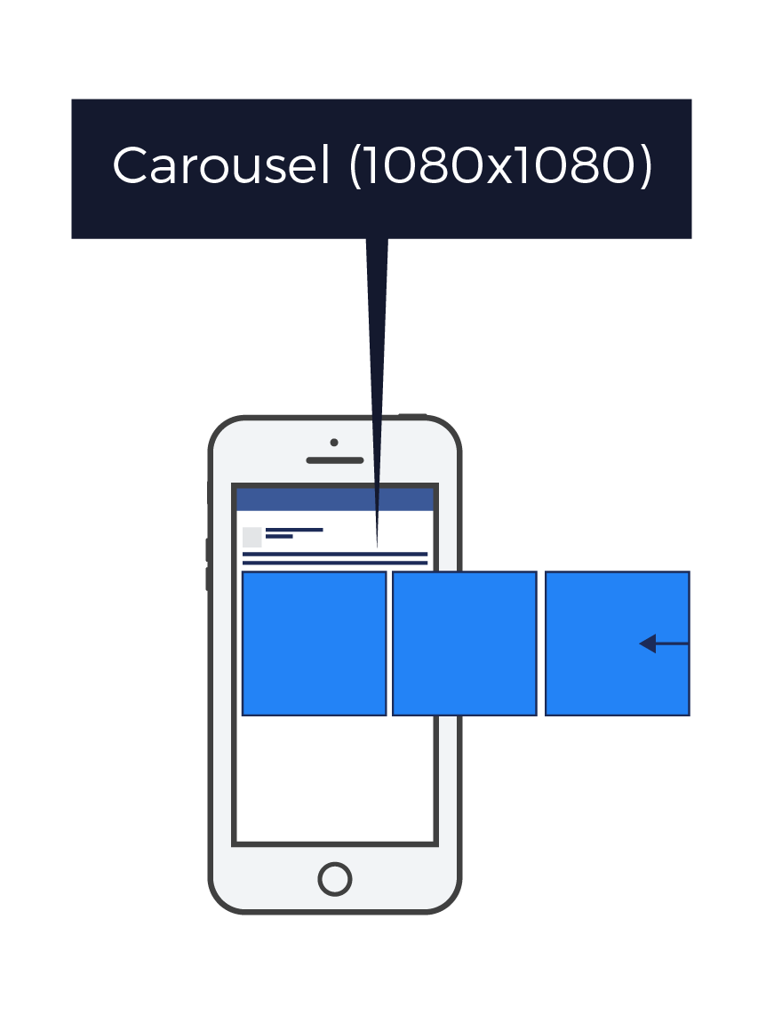
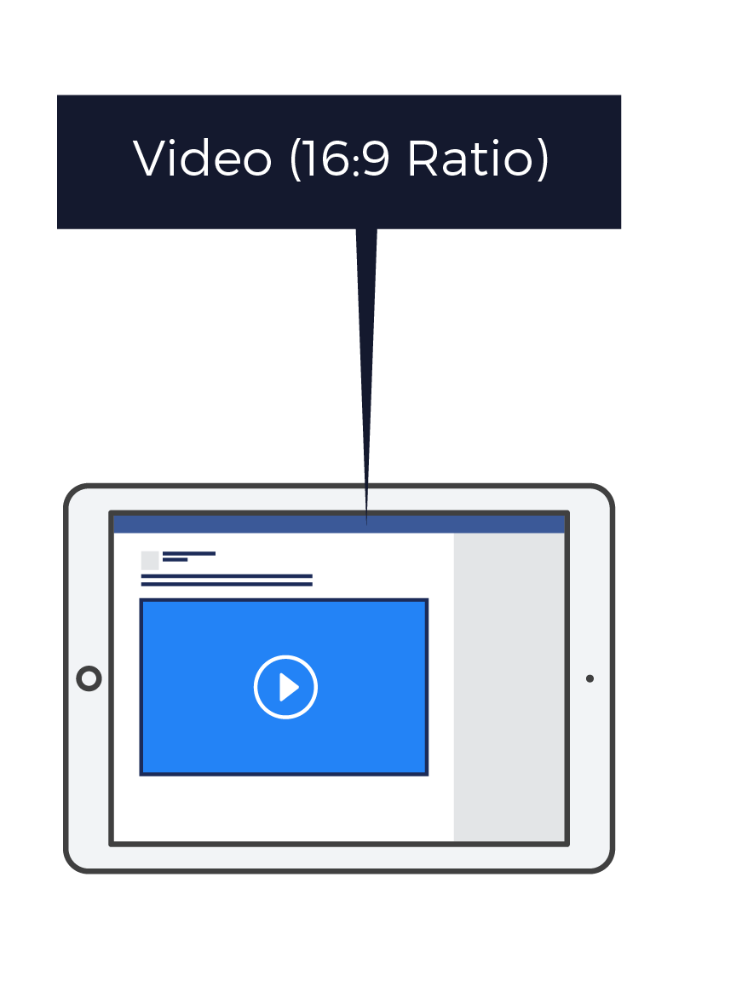
Social Ad Sizes
Facebook & Instagram

Slide 44
Behavioral Targeting
Cookies are used to track consumers’ online behaviors and activities. Consumer profiles are created, and if a consumer is determined to be relevant to an ad, we’ll try to serve the ad to that person. These ads are not served specifically to our first party audiences.
I recently searched things to do in Hawaii and now I’m seeing ads for hotels on the Island, even though the website and the article are unrelated to Hawaii.
Visuals for mockup purposes only.

Slide 45
Contextual Targeting
Ads that are shown an are directly relevant to the site’s content. For example, an ad for a hotel may appear on websites related to travel, vacationing, or tourism.
These ads are not served specifically to our first party audiences.
Travel-related ad on a travel-related website
Visuals for mockup purposes only.

Slide 46
Keyword Search Targeting
We will target keywords relevant to your client’s advertisement. We will then serve the ads to consumers who search for those keywords on search engines such as Google or Bing.
These ads are not served specifically to our first party audiences.
I recently searched for “best ski resorts in New England” and now I’m seeing ads for Stowe Mountain, VT
Visuals for mockup purposes only.

Slide 47
Website Retargeting
Ads are served to consumers after they visit the client’s website. The goal is to get them to come back again to convert.
These ads are not served specifically to our first party audiences.
I recently visited a website that sells silicone wedding bands and now I see them advertised as I browse other websites
Visuals for mockup purposes only.

Slide 48
Appendix:
Attribution and Measurement
‹#›

Slide 49
Cross-Device Pixel Report
This report shows you how many consumers saw your ad and visited your website to convert, even if the consumer didn't click on your ad.
We can also show you the number of people who see your ad on one device, but visited your website and converted at a later time on a completely different device.
Visuals for mockup purposes only.

Slide 50
Matchback Report
At the end of your campaign, we can share a matchback report as an add-on.
This report gives you a list of the first & last name and street address of each person who received your ad.
You can then compare this list of people to those who took an action from your campaign in order to determine the your campaign ROI.
We have targeted 63,274 people in your campaign with email & multi-channel ads. Once the campaign ends, we will send you an excel file with the names & addresses of each of those 63,274 people.
Visuals for mockup purposes only.
Notes:
B2B - speak to B2B, people not just consumer

Slide 51
Foot Traffic Attribution
Foot Traffic Attribution (FTA) measures how many real, verified people visited a physical location or point-of interest based on your ad campaign.
FTA allows you to quantify in real-time how your ad impressions led to in-store and point-of-interest visits.
This turnkey solution does not require any advertiser set-up or additional integration.

Slide 52
Pixel Tracking
We will create the pixel for your advertiser based on their specific goals and the actions they'd like to track
We will send you the pixel code as an email attachment with instructions on how to place on website
Once the pixel code is placed on the advertiser's website, it will begin to track specific actions
The pixel then sends us an alert when consumers complete the action
The alert will appear as a conversion on your campaign reporting
Visuals for mockup purposes only.

